Slide 1
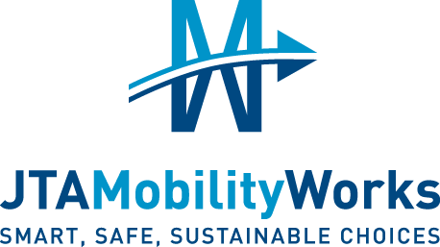
Alta Drive Roadway Project From I-295 Exit to Burkit Lane
Pre-Construction Open House
January 28, 2021
Oceanway Senior Center
Notes:
Welcome to the Pre-construction Open House for the JTA Mobility Works Project for Alta Drive. We are excited to partner with the local community to successfully implement improvements in the traffic flow and capacity throughout the roadway corridor.

Slide 2
Purpose
Provide an overview of the planned project
Review plans
Discuss project considerations
Solicit community feedback on the proposed improvements
Notes:
With construction just weeks away, today’s open house is to provide you with final details and answer any final questions before we begin. Exhibits are mounted on the large display boards located around the room for you to view. Project team members are available to answer any questions you may have and to discuss the various project components and considerations. We are very interested in your comments and feedback so please feel free to speak with a project team member or fill out a comment card.

Slide 3
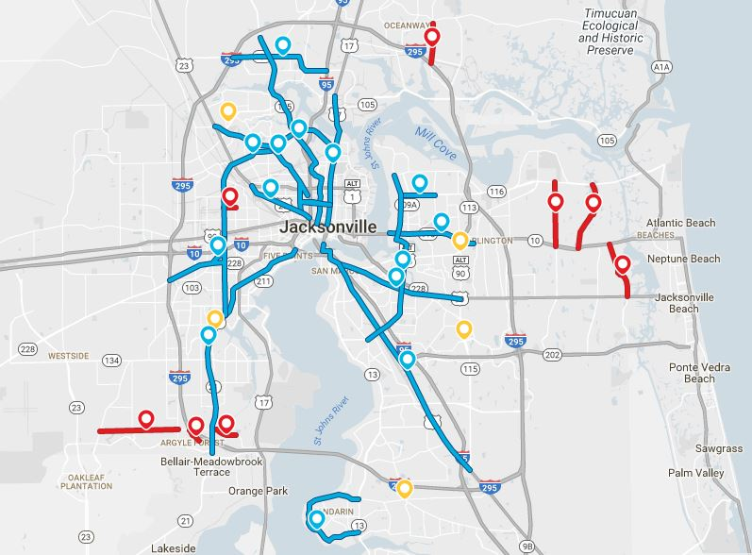
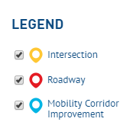
JTA PROGRAM OVERVIEW
13 Roadway Projects
14 Mobility Corridors
Notes:
This project is part of the JTAMobilityWorks program which includes 13 roadway and 14 mobility corridor projects, all of which are shown on the map. As you can see, the projects are located throughout Duval County.
The 13 roadway projects include design and construction of 10 projects on city roads and design only of 3 projects on state roads. Mobility corridors are designed to improve access to transit and provide mobility for all users.

Slide 4
PROJECT OVERVIEW
Funded from bonds issued against the extension of the Local Option Gas Tax (LOGT)
Interlocal agreement with the City of Jacksonville
Estimated total project cost of $38.4 million
Total project length of 1.67 miles
Roadways
Corridors
JTAMobilityWorks.com
Notes:
The JTA Mobility Works program is funded through bonds issued against the extension of the Local Option Gas Tax in Duval County. In 2014, the City of Jacksonville authorized JTA to implement and complete the program utilizing the LOGT. The Alta Drive Roadway Project has an estimated total cost of $38.4 million dollars and upon completion, the total project length will encompass 1.67 miles.
We encourage you to visit our website at JTA Mobility Works dot com for more information on this and all our projects.

Slide 5
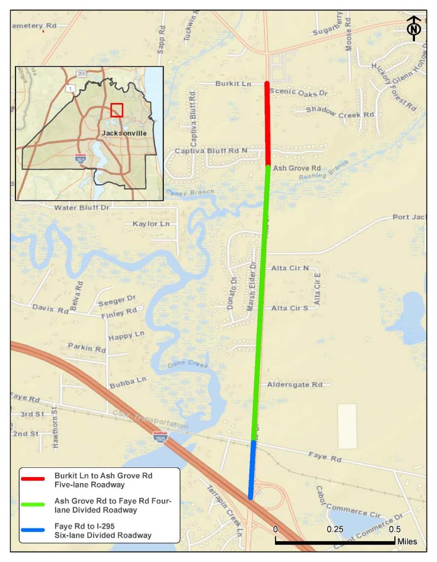
PROJECT SCOPE
Six-lane divided urban section from the I-295 exit to Faye Road
Four-lane urban section to Ashgrove Road
Five-lane urban section to Burkit Lane
Notes:
This project runs from the I-295 Southbound Exit, South of Faye Road to Burkit Lane. The project scope includes widening of the existing roadway to a six-lane, divided roadway from the I-295 exit to Faye Road, a four-lane urban roadway to Ashgrove Road and a five-lane roadway to Burkit Lane. The improvements will accommodate future traffic volumes and increase neighborhood connectivity.

Slide 6
PROJECT SCOPE
Bike lanes, sidewalks and a closed drainage system
Lighting
Re-striping of the bridge over Dunn Creek to provide four lanes for vehicles
New or upgraded signals at Faye Road, Misty Marsh Drive, and Port Jacksonville Parkway
Reconstruct CSX railroad crossing at Faye Road
Notes:
To promote mobility along the corridor, the project will also feature bike lanes and sidewalks. These are improvements that will benefit all users.
The bridge will be restriped to create an additional north and south bound lane to match the new construction. Drainage improvements will also be made to maintain existing drainage patterns and minimize the potential for localized flooding.

Slide 7
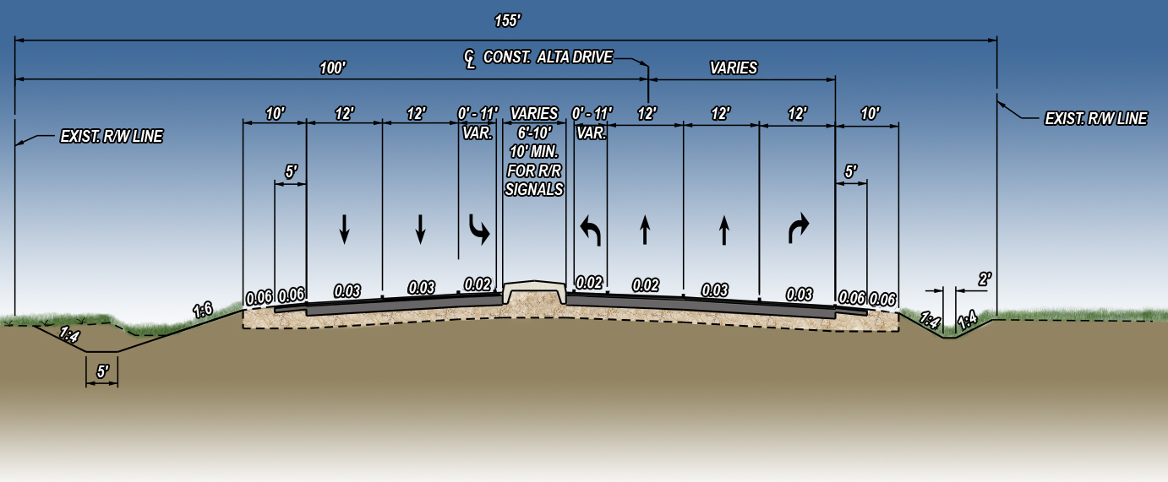
TYPICAL SECTION ONE
I-295 and Faye Road
Notes:
There are four primary typical sections that comprise the project. South of Faye Road and between I-295 and Faye Road.
Consists of: 4 – twelve foot wide travel lanes turn lanes, a five foot paved shoulder on each side as well as a raised wide median separating travel in each direction and housing railroad crossing gates.

Slide 8
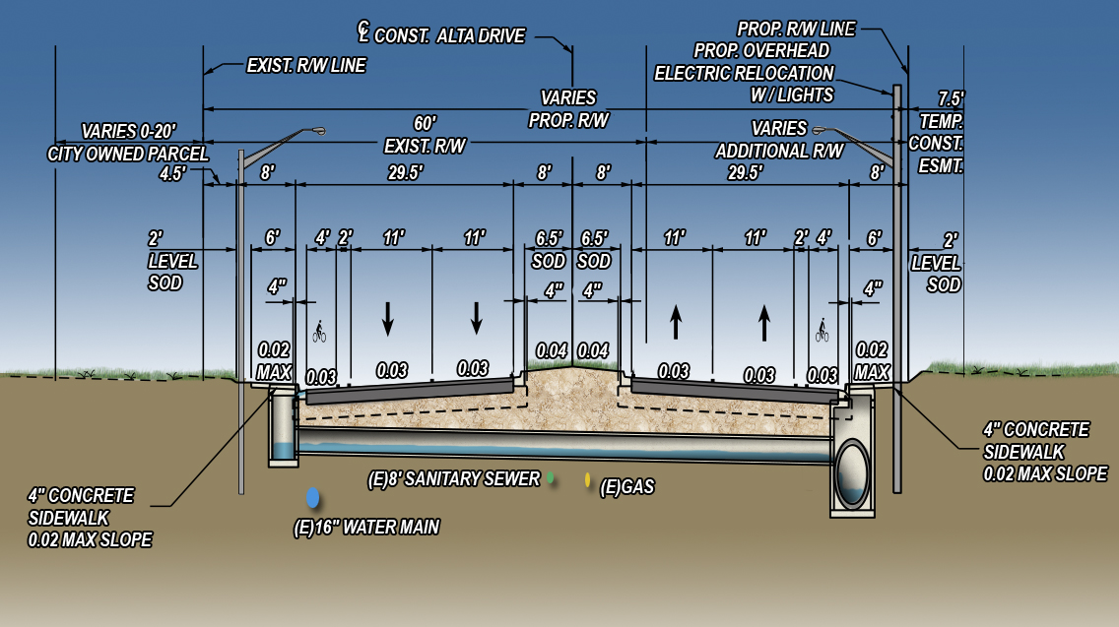
TYPICAL SECTION TWO
Faye Road and Donato Drive
Notes:
South of the bridge and between Faye Road and Donato Drive North. Consists of: 4 – eleven foot wide travel lanes, a six foot buffered bike lane on each side as well as 6 foot sidewalks on each side. There will be a raised 16 foot wide median separating travel in each direction. It should be noted that the widening from Faye Road to Burkit Lane requires extensive clearing in the right of way up to 60’ in width at some locations. JTA has minimized this as much as possible as evidenced by the 11’ lanes and other space saving features of our design.

Slide 9
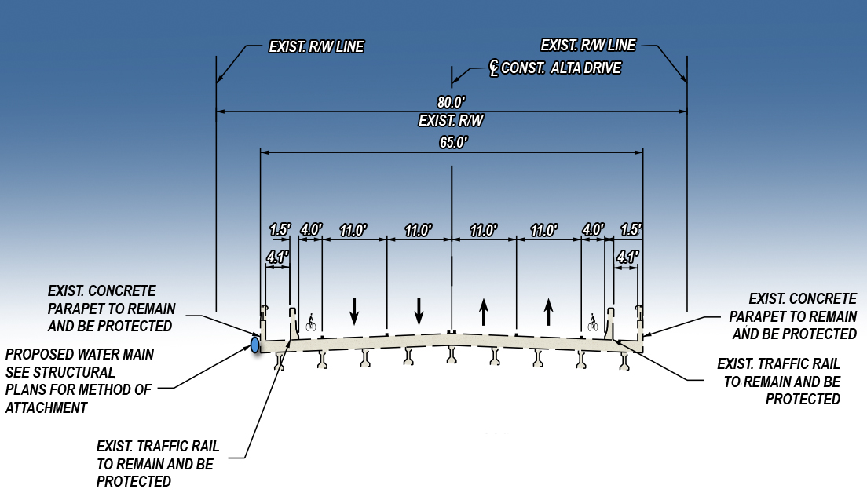
TYPICAL SECTION THREE
Rushing Branch Bridge
Notes:
The existing bridge over Rushing Branch will be re-striped to accommodate four 11 foot travel lanes and bike lanes and a protected sidewalk as well as an upgraded 16” water main.

Slide 10
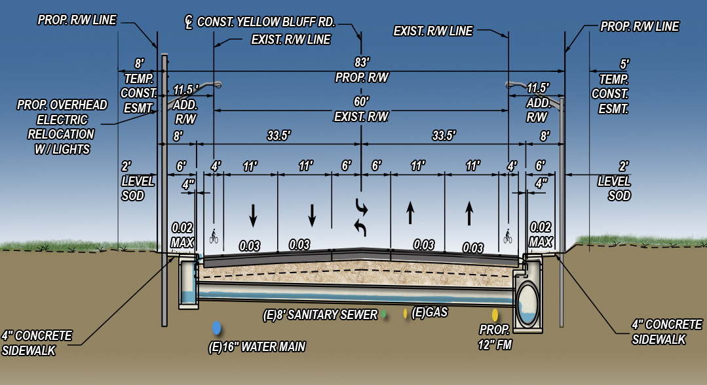
TYPICAL SECTION FOUR
Ashgrove Road to Burkit Lane
Notes:
North of the bridge, between Ashgrove Road and Burkit Lane will be a five lane section with 4 foot bike lanes and six foot wide sidewalks in each direction. The construction will require widening the right-of-way including clearing the existing trees and brush approximately 20 feet on each side. Again, JTA has minimized this as much as possible as evidenced by the 11’ lanes and other space saving features of our design.

Slide 11
PROJECT STATUS
Changes since January 2019:
JTA has completed plans and acquired all necessary permits: City of Jacksonville, FDOT, CSX, JEA and the St. Johns River Water Management District
Right-of-Way required to construct the project has been acquired
Design and Approval of a temporary detour (60 day maximum)
(Route detailed on next slide)
Project was bid and a construction contract has been executed
Notes:
There have been minimal changes to the project since the last Public Meeting held in January, 2019. At this time the JTA has completed the design and acquired all permits necessary to construct the project. Initial bids for this project were higher than the project budget. JTA worked with the City this fall to have a 60 day detour implemented during the project. This change resulted in a cost savings to the project of almost 1.5 million dollars allowing the project to move forward and providing an additional factor of safety for the traveling public and construction crews.

Slide 12
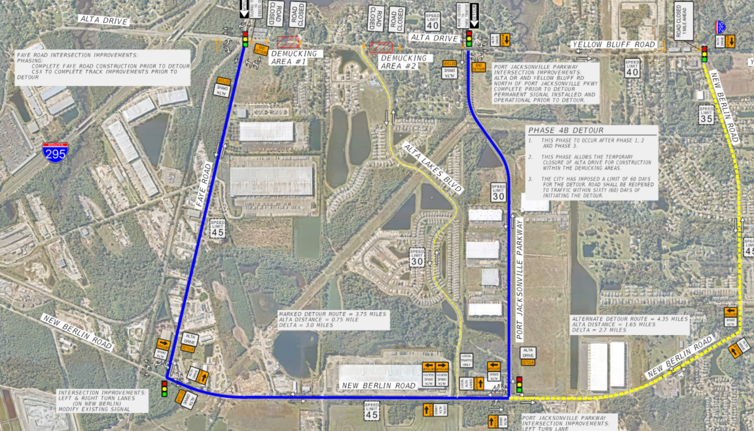
PROJECT STATUS
Changes since January 2019 (Cont.):
Notes:
The 60 day detour will be implemented in Phase 4B of the project’s construction. Phase 4B is expected to occur approximately one year into this approximately two year construction project. Implementing the detour is dependent on completing the improvements at the railroad tracks and permanent improvements at all four intersections along the route. These operational improvements will enhance traffic flow and have been analyzed to ensure the detour traffic will be accommodated acceptably even in the heaviest of the peak traffic hours.

Slide 13
TRAFFIC ANALYSIS
Additional lanes have been added for the length of the project to add capacity for current and future traffic demands
Additional lanes and revisions to the traffic signal at Faye Road to handle the traffic and heavy turning movements
New traffic signals at:
Port Jacksonville Parkway
Misty Marsh Drive/Alta Lakes Drive
Notes:
A traffic study analysis was conducted which analyzed existing traffic, turning movements and projected traffic volumes out to the year 2040. Projected traffic volumes 20 years into the future identified the need for additional travel lanes and traffic signals at Port Jacksonville Parkway and Misty March Drive/Alta Lakes Drive.

Slide 14
BENEFITS
Reduced congestion
Improved safety
New or upgraded signals
Improved drainage systems and ponds
JEA Potable Water and Sanitary Sewer Improvements to increase capacity and quality of service
Pedestrian and Bicycle accommodations
Notes:
The proposed improvements will fulfill the need for this project by relieving traffic congestion, controlling the turn movements, and improving safety with the addition of travel lanes, turn lanes, bike lanes, sidewalks and lighting. Drainage will improved throughout the corridor with the improvements to the drainage system and ponds. With the completion of the construction, there will be an increase in the quality of service through JEA potable water and sanitary sewer.

Slide 15
NEXT STEPS
Design Firm: England Thims & Miller, Inc. (ETM)
Complete Plans
Permitting
Right-of-way Acquisitions
Utility Coordination
Notes:
The project has completed the design phase where ETM (England Thims & Miller, Inc) provided complete design services, utility coordination and permitting services.

Slide 16
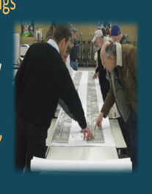
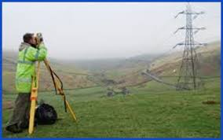
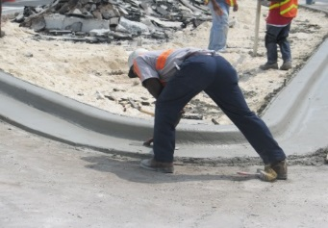
PROJECT SCHEDULE
Final Design Complete
Fall 2019
Construction Award
Spring 2021
Complete Construction
Spring 2023
Right-of-Way Acquisitions
Summer
2019
Through
2020
Summer
Notes:
What’s next for this project. The Design and Right-of Way Acquisition is now complete and project was bid for construction. Construction is expected to begin in the Spring. By the Spring of 2023, construction will be completed with an improved roadway that includes bike lanes and sidewalks and enough additional traffic capacity to serve this growing area for decades.

Slide 17
NEXT STEPS
Construction Firm: Watson Construction Company
Contract Execution
Finish Construction
Begin Construction
Phase 1 Completion
Feb 2021
Spring 2022
Spring 2023
Notes:
The JTA and the Contractor are currently executing the contract in preparation for a preconstruction conference and issuance of a formal “Notice to Proceed” to proceed to the contractor which is on track to occur in late February 2021 on this $22M construction contract. Phase 1 of construction will finish approximately 1 year later and the final 3 phases finish 1 year after that completing the project in the Spring of 2023. Please be advised that some activities for all phases may overlap one another and a detailed construction phasing plan has not been submitted at this time.

Slide 18
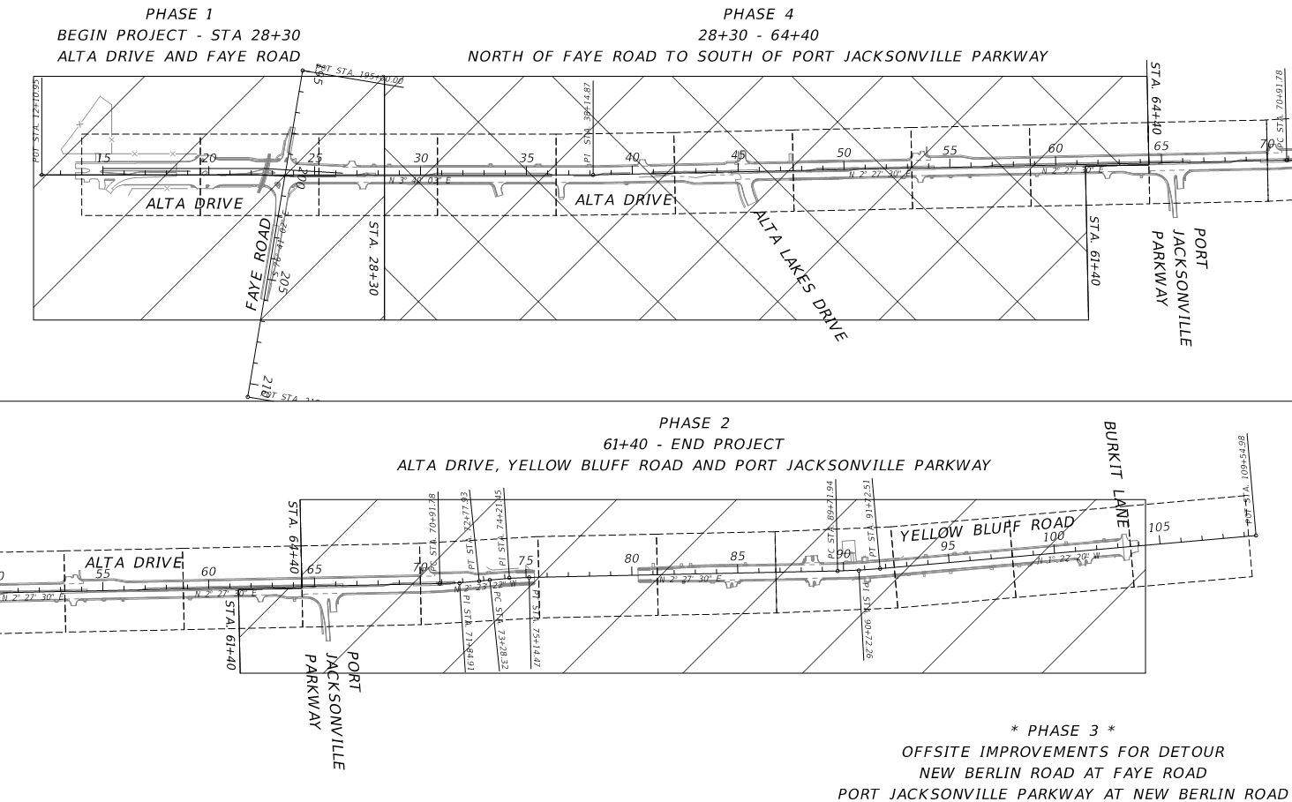
Construction Phasing
Notes:
Construction of Alta Drive and Yellow Bluff Road will be phased to allow the construction to be completed while maintaining access to the residents and businesses.
Shown here is an overview of the construction. Please be aware that where possible, the Contractor may be working in multiple locations simultaneously to expedite the construction activities.
Phase 1 is the construction on the additional lanes and railroad crossing south of Faye Road.
Phase 2 is the construction of Alta Drive and Yellow Bluff Road north of Port Jacksonville Parkway.
Phase 3 includes improvements to New Berlin Road to allow the construction of improvements along the temporary detour route mentioned earlier.
Phase 4 will include the 60 day detour and the remainder of the construction of Alta Drive between Faye Road and Port Jacksonville Parkway.
Please be aware that the 60 day detour is in order for specific areas within the Phase 4 construction, but the remaining Phase 4 construction will be completed following the reopening of Alta to through traffic..

Slide 19
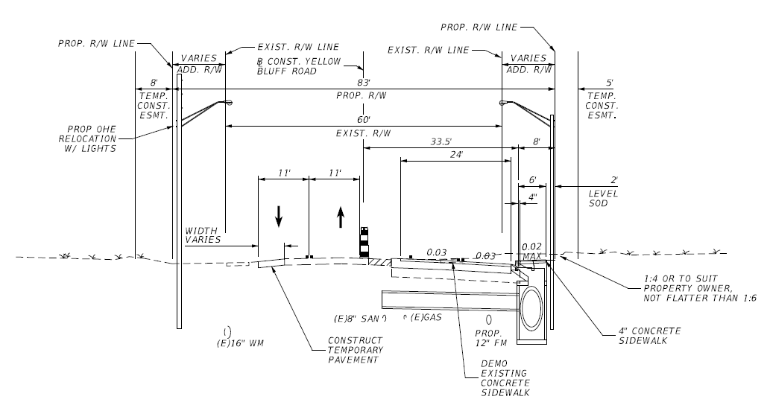
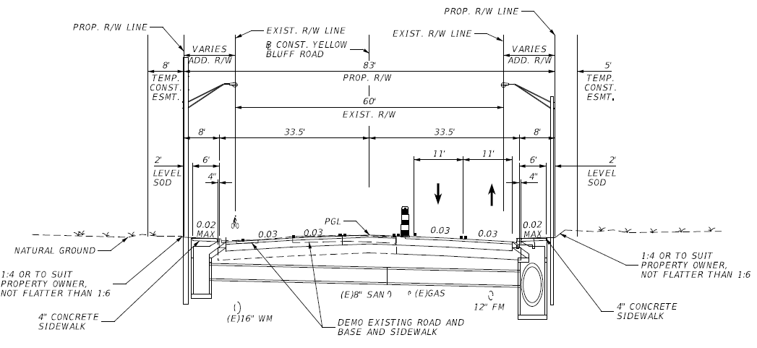
Construction Phasing
Alta Drive South of Rushing Branch
Construction Stage 2
Construction Stage 1
Notes:
Alta Drive south of Rushing Branch will be widened to the east approximately 40 feet. During construction the new right-of-way will be cleared and the new northbound lanes will be constructed east of the existing roadway. Once complete, traffic will be shifted to the new lanes, allowing the existing roadway to be remove and new lanes constructed.

Slide 20
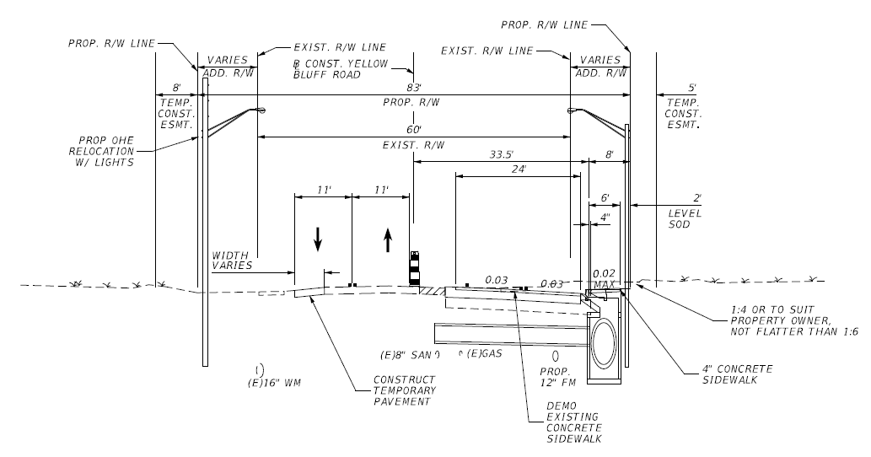
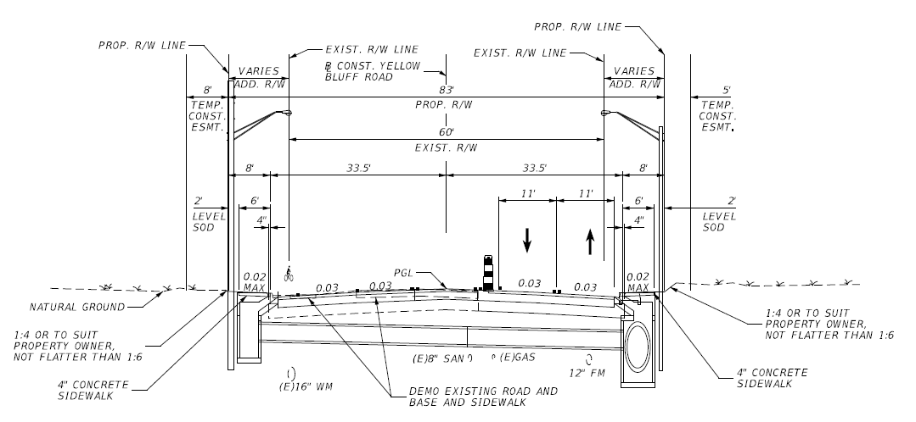
Construction Phasing
Yellow Bluff Road North of Rushing Branch
Construction Stage 2
Construction Stage 1
Notes:
Yellow Bluff Road north of Rushing Branch will be widened similar to Alta Drive, but with the narrower section and existing development there will be some temporary paving and widening to each side of the existing roadway. During construction the new right-of-way will be cleared and the new northbound lanes will be constructed east of the existing roadway. Once complete, traffic will be shifted to the new lanes, allowing the existing roadway to be remove and new lanes constructed.

Slide 21
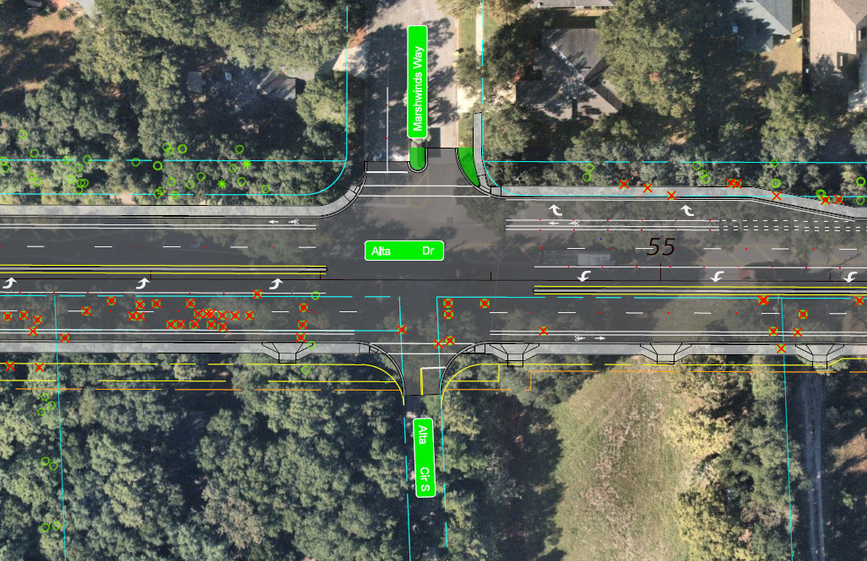
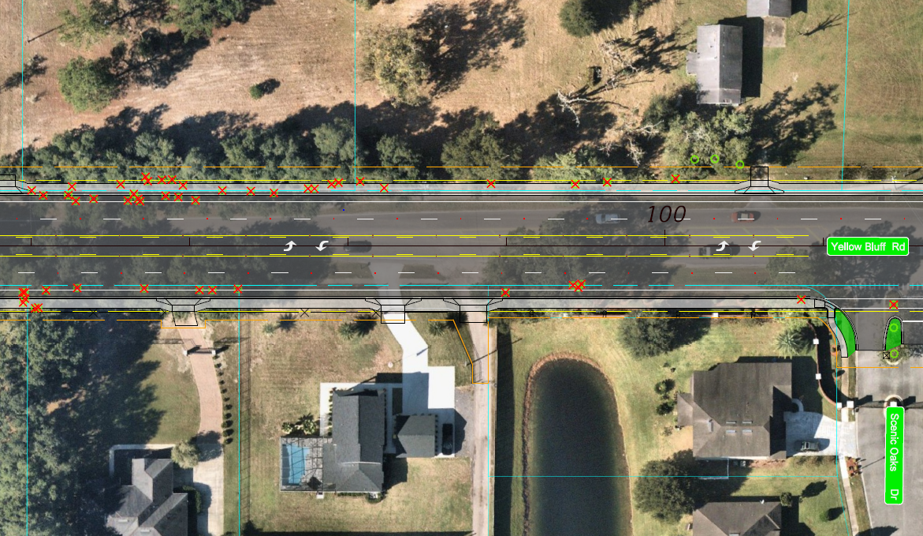
Clearing for Construction
Yellow Bluff Road North of Rushing Branch
Alta Drive South of Rushing Branch
Notes:
During construction the newly acquired right-of-way will be cleared and trees removed to allow for the construction of the expanded roadway. Here are two sections along the roadway showing the required tree removal typical for this project. Along Alta Drive south of Rushing Branch this clearing and tree removal will be mostly on the east side of the roadway. Along Yellow Bluff Road north of Rushing Branch the clearing will be more evenly divided between the east and west side of the roadway.

Slide 22
CONTACT INFORMATION
Kim Robinson
Jacksonville Transportation Authority
100 LaVilla Center Drive
Jacksonville, FL 32204
mobilityworks@jtafla.com
904.630.3141
Notes:
We appreciate your feedback on this important project. It belongs to you and if you have any questions, please contact Kim Robinson at either the address, email or phone number provided. The project team members are now available to answer any further questions you might have.

Slide 23
THANK YOU
The information contained in this presentation is for general information purposes only
Design or construction requirements may result in some changes to the concepts displayed herein
This presentation will start again in one minute
Notes:
The features shown in this presentation may change during design or construction as warranted due to changes in design or construction requirements.

