Slide 1
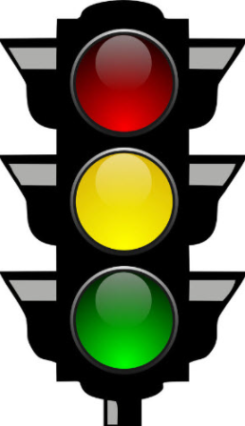
COJ Traffic Calming Program November 20th, 2023 by Chris LeDew, Chief of Traffic Engineering

Slide 2
Agenda:
The difference between speed humps, bumps, and tables
Traffic calming options
COJ Traffic calming process
Petition Process
Plantation Club Dr

Slide 3
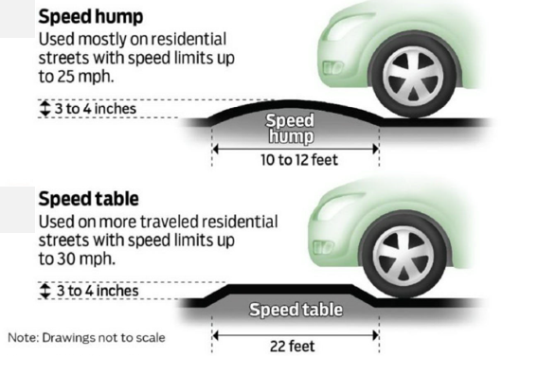
Speed Humps and Speed Tables
Notes:
Benefits of Speed humps:
-Slow traffic
-Physical barrier forces drivers to slow down
Negatives of Speed humps:
-Increase emergency response times
-Can increase noise

Slide 4
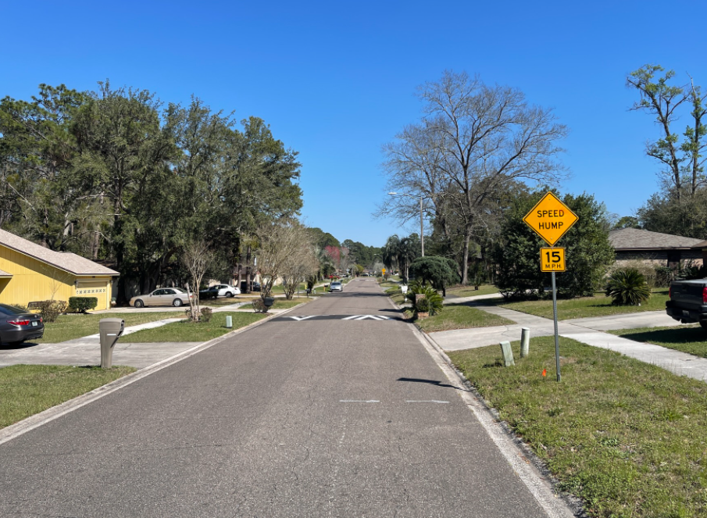
Speed Humps
Pros:
Slows traffic
Physical change to roadway
Cons:
May increase emergency response time
Turtle Creek
Notes:
Other complaints COJ has received:
-neck/back injuries
-lower property values
-noise

Slide 5
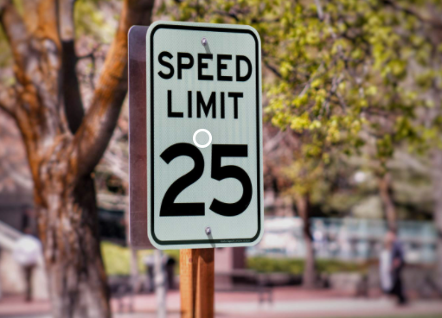
Lowering the posted speed limit
Pros:
Residents may feel safer
JSO can enforce at lower threshold
Cons
Signs may not change behavior

Slide 6
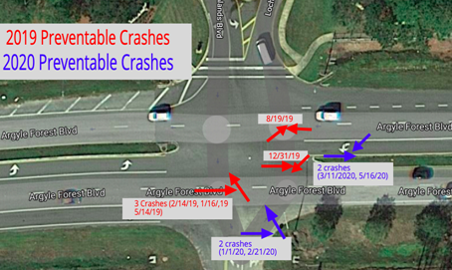
COJ Traffic Calming Process
Reported Crashes
Field Reviews
Speed Studies
Customer Complaints
Statistical comparison
Prioritized by crash rate
EXAMPLE
Notes:
6 reported crashes on Plantation Club Dr. No reported serious injuries.

Slide 7
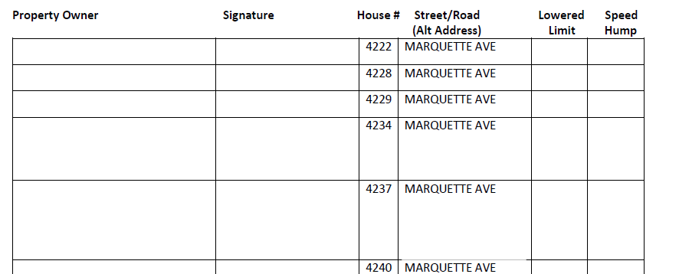
Petition Process
COJ Ordinance 2014-666-E
Neighborhood shares cost with COJ
EXAMPLE

Slide 8
Plantation Club Dr
4 Speed Humps
Shared Cost $12,000 ($3,000 each)
50% reduction Cut-thru
Community’s Cost $6,000
Notes:
Cost is typically 3K per speed hump, since Plantation Club Dr is a cut-thru the cost per speed hump to the community is 1.5K/ speed hump.

Slide 9
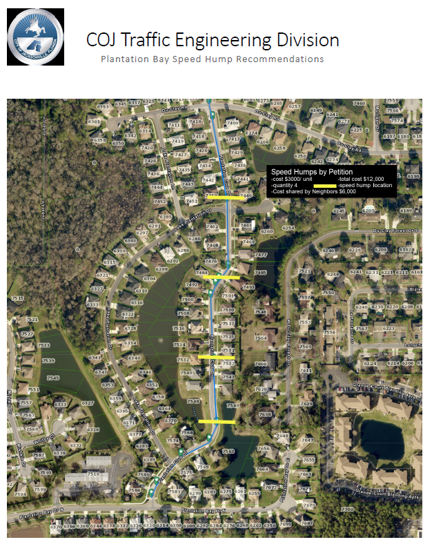
Notes:
Speed tables cost $ 6,400 each.
The picture shows 1/12 speed humps on Clyde Drive.

Slide 10
Questions?

