Slide 1
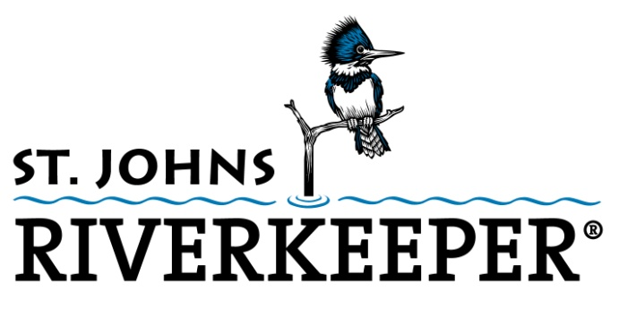
Green Infrastructure and the Lasalle Bioswale Project

Slide 2

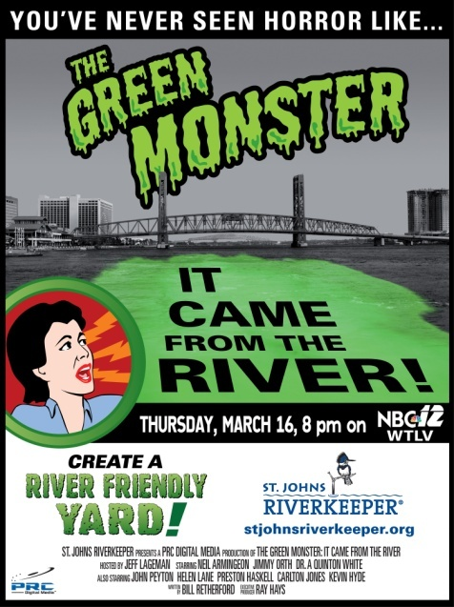

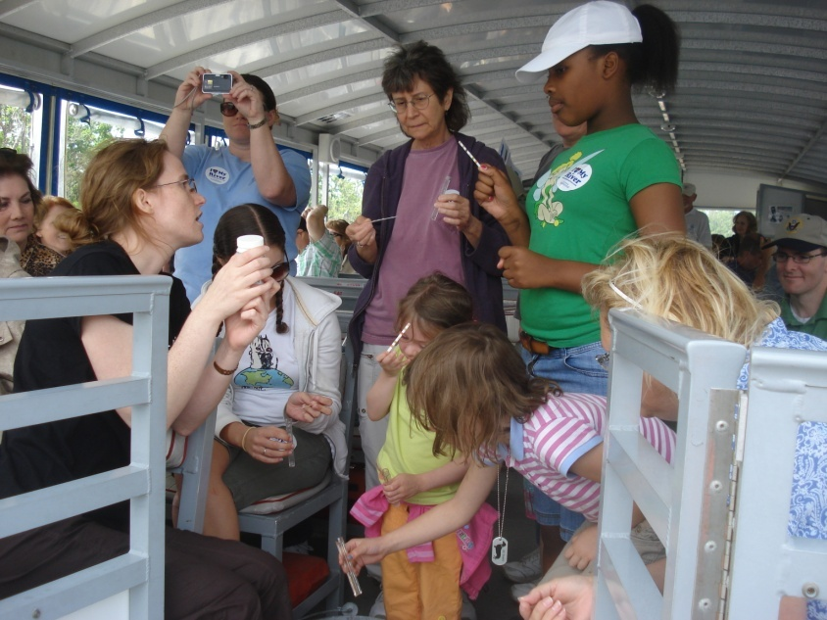
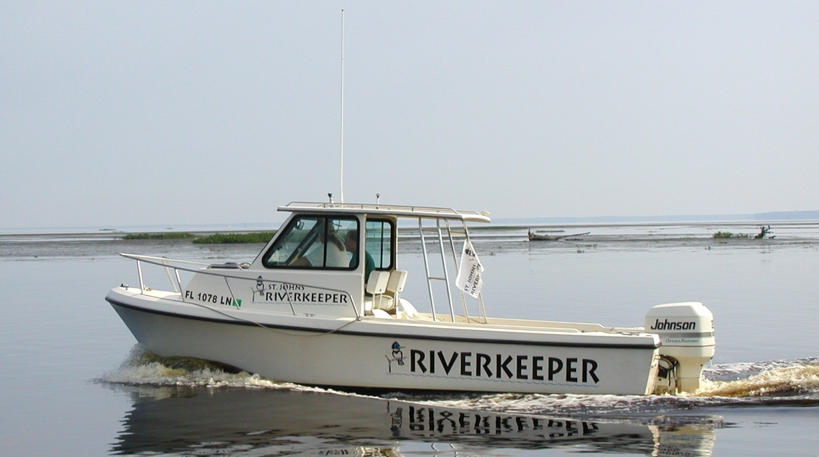
Investigate pollution problems
Advocate for policy changes
Seek solutions
Educate the public
Raise awareness
Engage and involve citizens
Notes:
St. Johns Riverkeeper is a non-profit 501(c)(3) organization that serves as a full-time advocate for the St. Johns River. We are an independent voice for the river.
St. Johns Riverkeeper is a membership-based organization that is privately funded. St. Johns Riverkeeper does not receive any government funding. We rely on the generous support of businesses and concerned citizens who recognize the importance of the St. Johns and the value of having a full-time advocate representing the interests of the river and the public to whom it belongs.
Photos: The St. Johns Riverkeeper on our boat, The Kingfisher; movie poster from our documentary, “The Green Monster”; Get Your Feet Wet guidebook to the St. Johns River from Palatka to the Atlantic; a volunteer leading a water quality testing activity with kids on one of our educational boat trips.

Slide 3
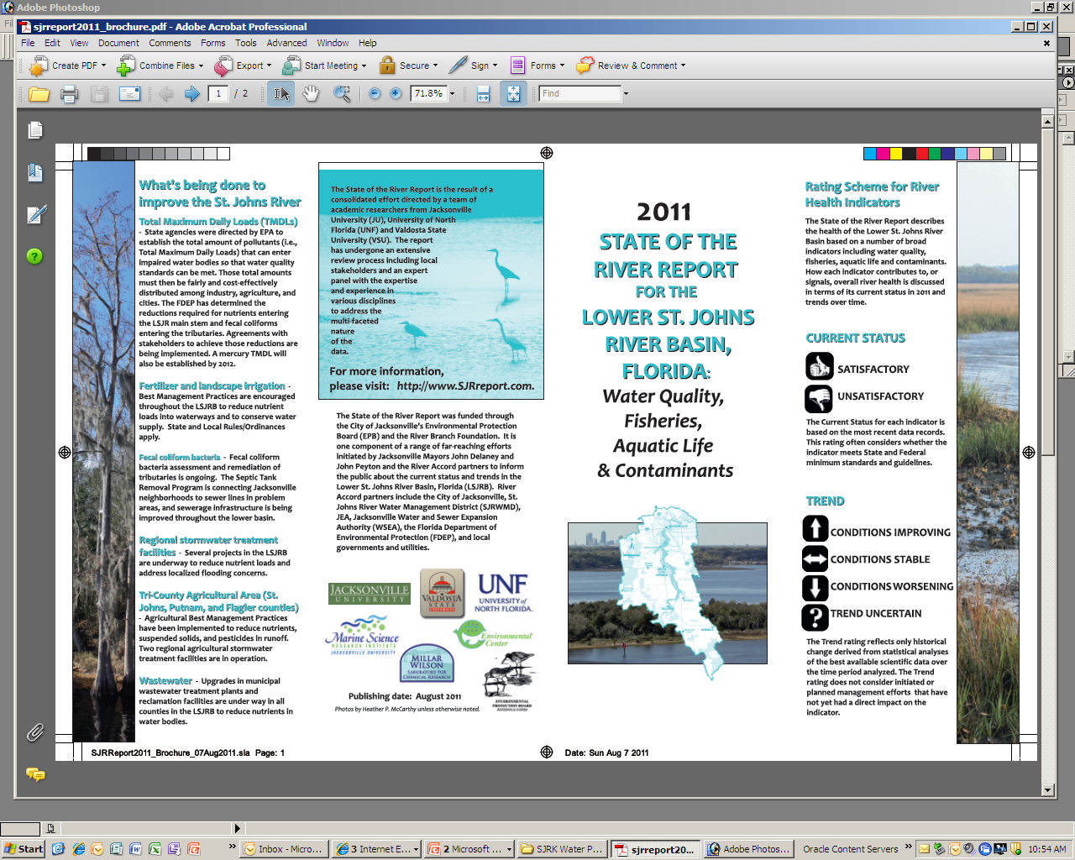


St. Johns River Report
Current Status
Trends
www.sjrreport.com
Notes:
The State of the River Report for the Lower St. Johns River Basin is the result of a collaborative effort of a team of academic researchers from Jacksonville University, the University of North Florida and Valdosta State University. The purpose of the project, funded primarily by the Environmental Protection Board of the City of Jacksonville, is to annually review previously collected data and literature about the Lower St. Johns River Basin (Atlantic Ocean to south of Palatka), providing an analysis of the current state of the river’s health and an assessment of trends for the various indicators that were evaluated.
We are hoping that the report can eventually be expanded to include the entire watershed and additional universities.
Thumbs down = often means that indicators do not meet state and federal minimum standards and guidelines
Thumbs up = means indicator does consistently meet standards
Arrow up = conditions are improving
Arrow down = conditions worsening
Arrow side to side = conditions stable
Question mark = trend uncertain, data is often incomplete or inconsistent

Slide 4

Nutrient Pollution
Excessive loading of nitrogen and phosphorous
Triggers toxic algal blooms
Sources: wastewater treatment plants, industrial discharge, septic tanks, fertilizers from yards and agriculture
Algal Blooms
Deplete oxygen, cause fish kills
Reduce light to submerged aquatic vegetation (SAVs)
Emit toxins harmful to humans and wildlife
Notes:
Nutrient pollution continues to be one of the most significant problem impacting the health of the main stem of the river and many waterways throughout the state.
Excessive nutrients feed uncontrolled algal blooms that deplete oxygen in the water needed by fish, reduce light that is essential to submerged aquatic vegetation (SAVs), and threaten the health of both humans and aquatic life by emitting toxins.
The excess nutrients come from wastewater treatment plants, industrial discharges, failing septic tanks, stormwater runoff, and fertilizers that wash into the river.
An algal bloom is a rapid increase in the population of algae in an aquatic system.

Slide 5
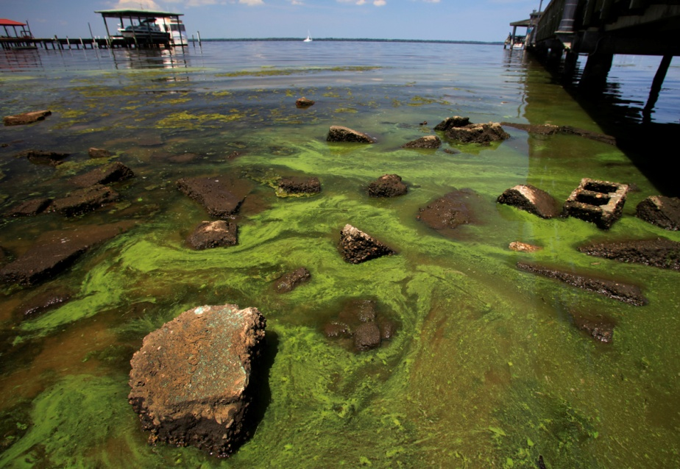
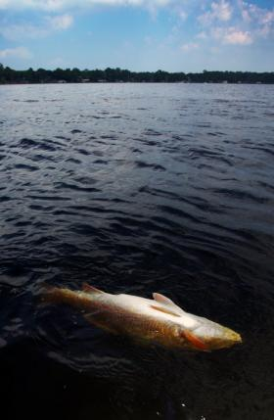
Notes:
The photo of the dead redfish was taken during a massive fish kill in the summer of 2010.
The photo of the algal bloom was taken in Green Cove Springs in 2010 at the City Pier. Photo credit: Walter Coker
The fish kill is thought to be related to toxins that are released from certain types of algae.

Slide 6
Bacteria
75 tributaries in the Lower St. Johns River are impaired.
16,000 septic tanks within a 300-meter buffer of the St. Johns River
$320 million = projected cost to provide sewer service to these homes
37 Septic Tank Failure Areas in Duval with over 23,000 septic tanks
Sources: failing septic tanks, wastewater treatment plants, broken sewer lines, and animal waste
Notes:
Elevated levels of fecal coliform bacteria is one of the most significant problems impacting the health of the river’s tributaries. Seventy-five tributaries in the Lower St. Johns River have been verified as impaired because of elevated bacteria levels.
Bacteria pollution comes from failing septic tanks, wastewater treatment plants, broken sewer lines, and animal waste.
Nutrients released with sewage may cause algal blooms, and exposure to fecal bacteria can pose a risk to human health.
There are more than 16,000 septic tanks within a 300-meter buffer of the St. Johns River and its tributaries. It is projected to cost more than $320 million to provide sewer service to these homes.
While high fecal counts continue to impair most tributaries of the St. Johns River in the Lower Basin, the report did show an improvement in some of the creeks.
The number of Septic Tank Failure Areas and estimate of septic tanks within those areas was provided by Scott Turner from Duval Health Department on Sept. 29, 2011.

Slide 7
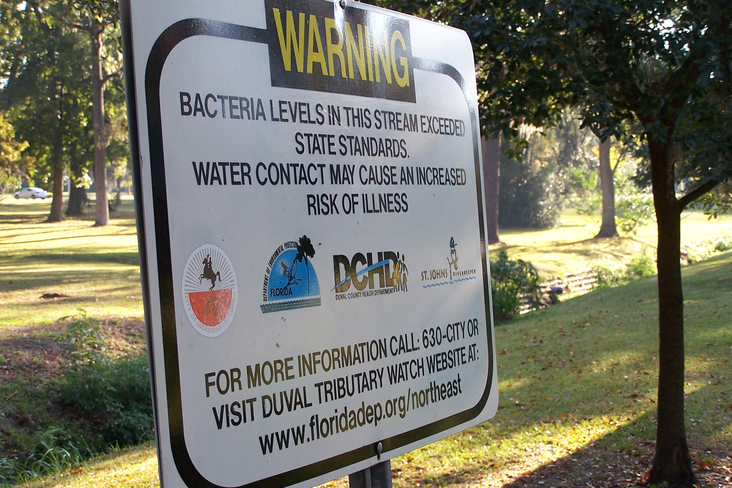
Notes:
This is a sign at Willowbranch Park in Riverside warning of the health risks from exposure to the creek’s waters. Willowbranch consistently has some highest fecal coliform bacteria counts.

Slide 8

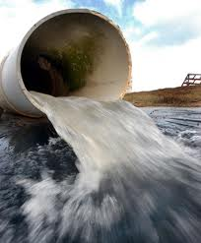
Stormwater Runoff
Fertilizers
Bacteria
Metals
Hydrocarbons
Herbicides
Pesticides
Sediments
Debris
Notes:
The goals for stormwater management within the State of Florida are outlined in Chapter
62-40 of the Florida Administrative Code (FAC), titled “Water Resource Implementation Rule”.
This rule establishes that stormwater design criteria adopted by FDEP and the water
management districts shall achieve at least 80% reduction of the average annual load of
pollutants that cause or contribute to violations of State Water Quality Standards. When the
stormwater system discharges to an Outstanding Florida Water (OFW), the design and
performance criteria increases to 95% reduction.
On an average basis, wet detention systems with a detention time of 14 days can be
expected to provide a net removal of approximately 20-40% for total nitrogen; 60-70% for total
phosphorus and copper; and 75-85% or more for TSS, total lead and total zinc.
Source: http://www.dep.state.fl.us/water/nonpoint/docs/nonpoint/SW_TreatmentReportFinal_71907.pdf

Slide 9
Green Infrastructure &
Low Impact Development (LID)
Bioswales
Rain gardens
• Trees & native plantings
• Pervious pavers and concrete
Enhanced stormwater basins
Green roofs
Rain barrels/ rainwater harvesting
Notes:
Green Infrastructure and Low Impact Development practices offer alternative approaches to efficiently and effectively manage stormwater. These strategies involve the use of trees, plants, and green spaces to slow down, capture, and treat stormwater. GI and LID strategies often involve diverting and detaining stormwater to where it can infiltrate into the ground, evaporate, be taken up by plants, or reused.
According to the U.S. Environmental Protection Agency (EPA) website:
"LID is an approach to land development (or re-development) that works with nature to manage stormwater as close to its source as possible. LID employs principles such as preserving and recreating natural landscape features, minimizing effective imperviousness to create functional and appealing site drainage that treat stormwater as a resource rather than a waste product. By implementing LID principles and practices, water can be managed in a way that reduces the impact of built areas and promotes the natural movement of water within an ecosystem or watershed."
In April of 2012, Philadelphia and EPA announced a $2 billion agreement to use green infrastructure to manage stormwater. They have recognized the benefits of these strategies and have completely embraced them in their quest to be one of the greenest cities in America.
http://www.bna.com/epa-philadelphia-sign-n12884908869/
Philly’s Green City, Clean Waters Plan
http://www.phillywatersheds.org/what_were_doing/documents_and_data/cso_long_term_control_plan
Resources:
What is Green Infrastructure? http://water.epa.gov/infrastructure/greeninfrastructure/gi_what.cfm
Going Green to Save Green: Economic Benefits of Green Infrastructure Practices
http://www.americanrivers.org/library/reports-publications/going-green-to-save-green.html
San Mateo Sustainable Streets and Parking Lots Design Guidebook
http://www.flowstobay.org/ms_sustainable_streets.php
Guide to help municipalities monetize the value of green infrastructure
http://www.cnt.org/news/2011/01/21/new-guide-helps-municipalities-monetize-the-value-of-green-infrastructure-2/
The Value of GI Guide
http://lafoundation.org/news-events/blog/2011/08/15/lp-value-of-green-infrastructure
NRDC: Rooftops to Rivers
http://switchboard.nrdc.org/blogs/ngarrison/nrdcs_report_shows_that_green.html
ASLA releases database of 479 GI projects and case studies
http://switchboard.nrdc.org/blogs/kbenfield/how_green_infrastructure_for_w.html
"Watersheds, Walkability and Stormwater: The Role of Density"
http://www.urban-nature.org/publications/documents/WatershedsWalkabilityandStormwater.pdf

Slide 10
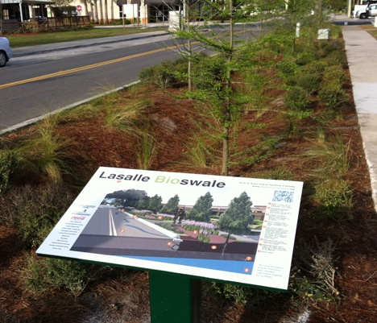
Lasalle Bioswale Project
Notes:
One example of a Green Infrastructure or Low Impact Development strategy is the use of a bioswale.
In December of last year, St. Johns Riverkeeper and numerous partners collaborated to install the City of Jacksonville’s first bioswale along Lasalle Street in front of the San Marco Library.

Slide 11
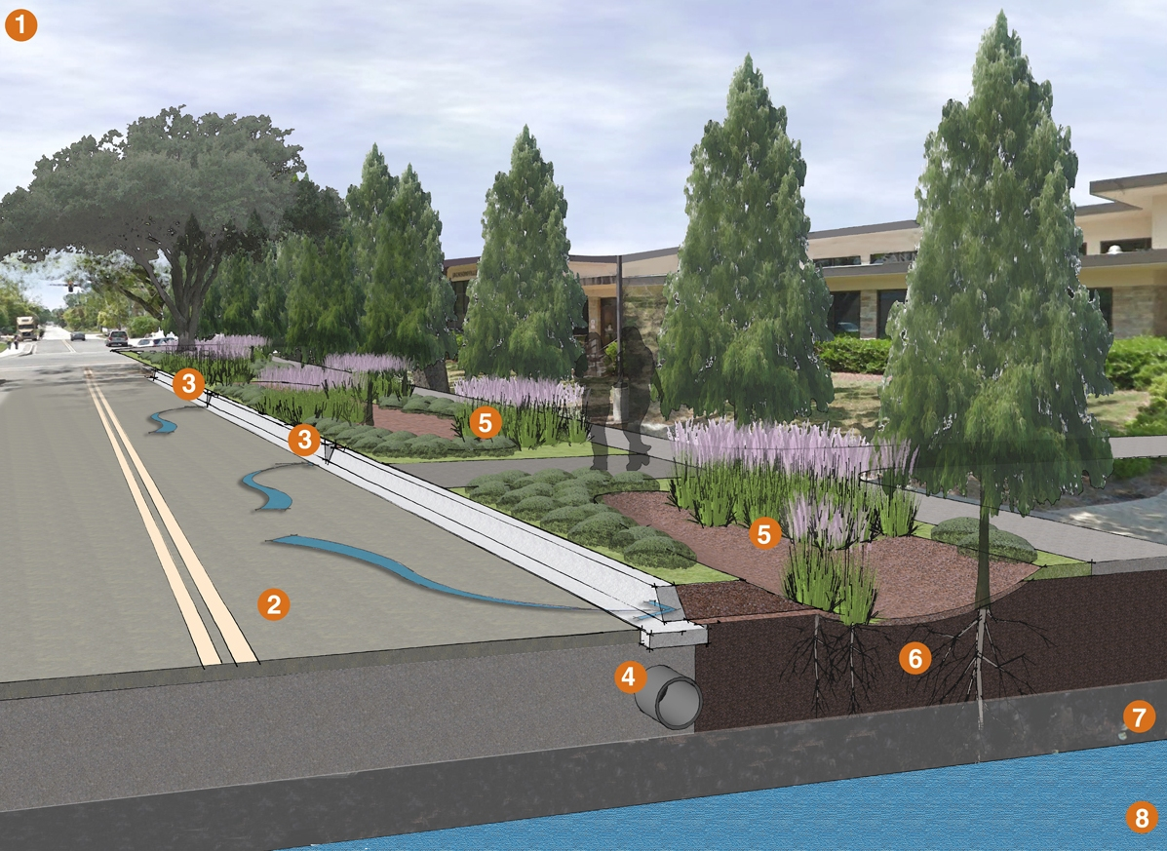
Notes:
A bioswale collects stormwater runoff from roads, rooftops, and parking lots and uses soil and plants to remove pollution before the water reaches the St. Johns River.
Funded by a grant from Coca-Cola, the bioswale was installed to demonstrate how Low Impact Development (LID) or Green Infrastructure strategies can be effectively utilized to manage and treat stormwater.
LID and Green Infrastructure strategies attempt to work with nature to manage stormwater as close to its source as possible. They often involve the utilization of plants, trees, soil, and permeable pavement materials. Some examples of LID/GI practices include rain gardens, green roofs, constructed wetlands, tree plantings and tree boxes, and rainwater harvesting techniques.
A portion of the runoff from Lasalle Street and the surrounding area will now be diverted into the bioswale, helping to clean the stormwater before it enters our river.
Previously, this water was diverted into storm drains and went straight to the river untreated, carrying with it fertilizers, chemicals, and other pollutants.

Slide 12
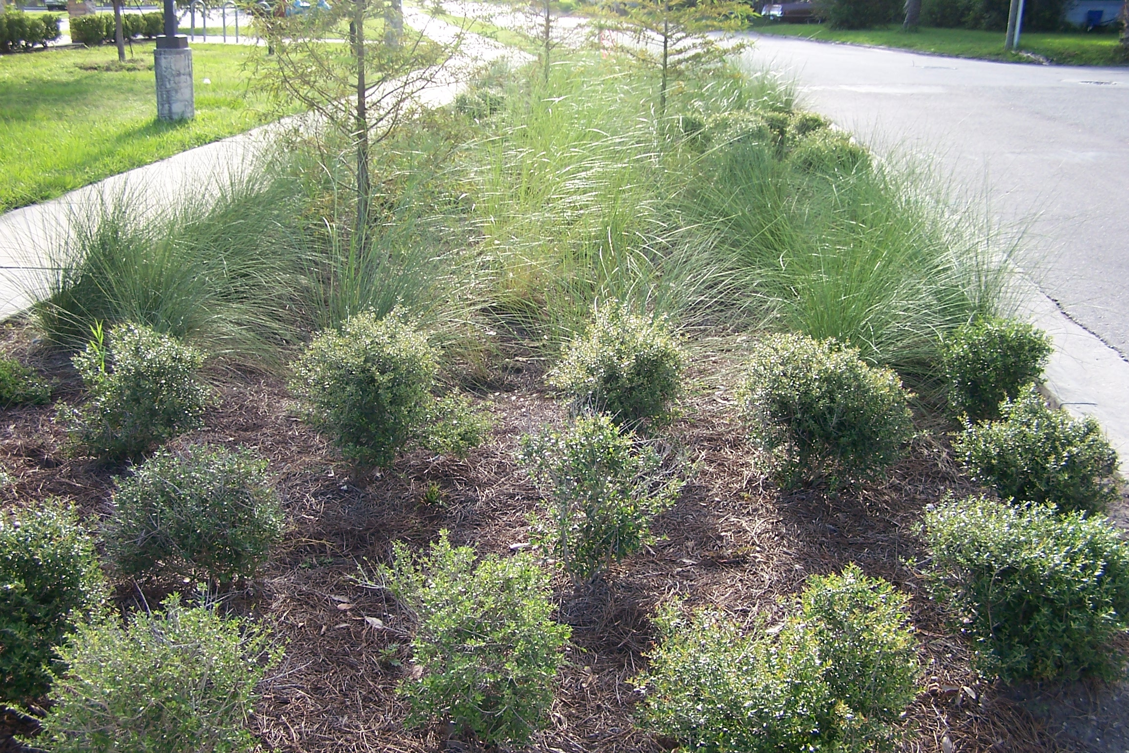

Slide 13
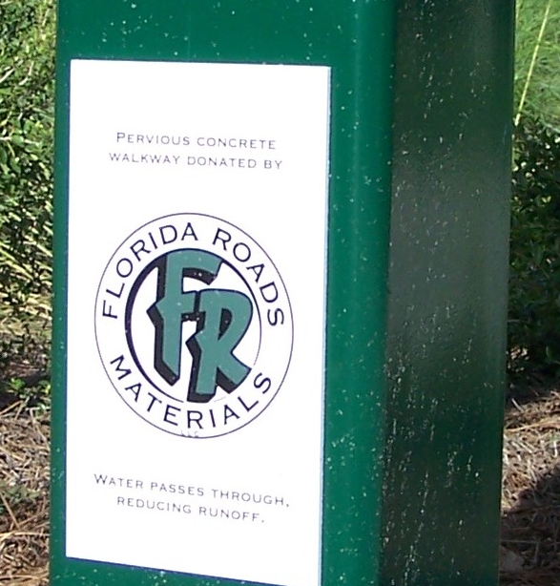
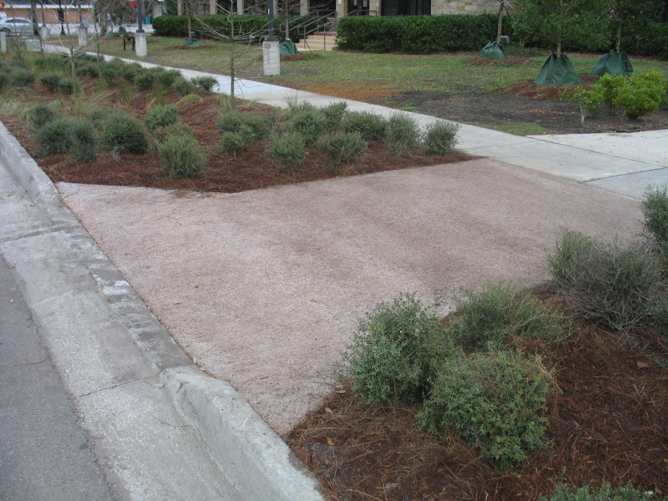
Notes:
Here is pervious concrete walkway that was donated by Florida Roads to the bioswale project. Pervious concrete and pavement materials allow water to pass through and percolate down through the soil instead of running off into nearby stormdrains and waterways.

Slide 14
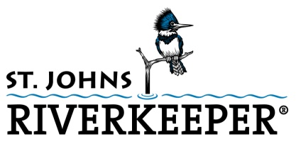
Partners
City of Jacksonville
Coca-Cola
Content Design Group
Councilwoman Lori Boyer
EnVision Design + Engineering
Florida Roads
Greenscape of Jacksonville
Jacksonville Zoo and Gardens
Jacksonville Public Library
Media Works
MetroVerde
PBM Constructors
Petticoat-Schmitt Contracting
San Marco Preservation Society
Superior Trees

Slide 15
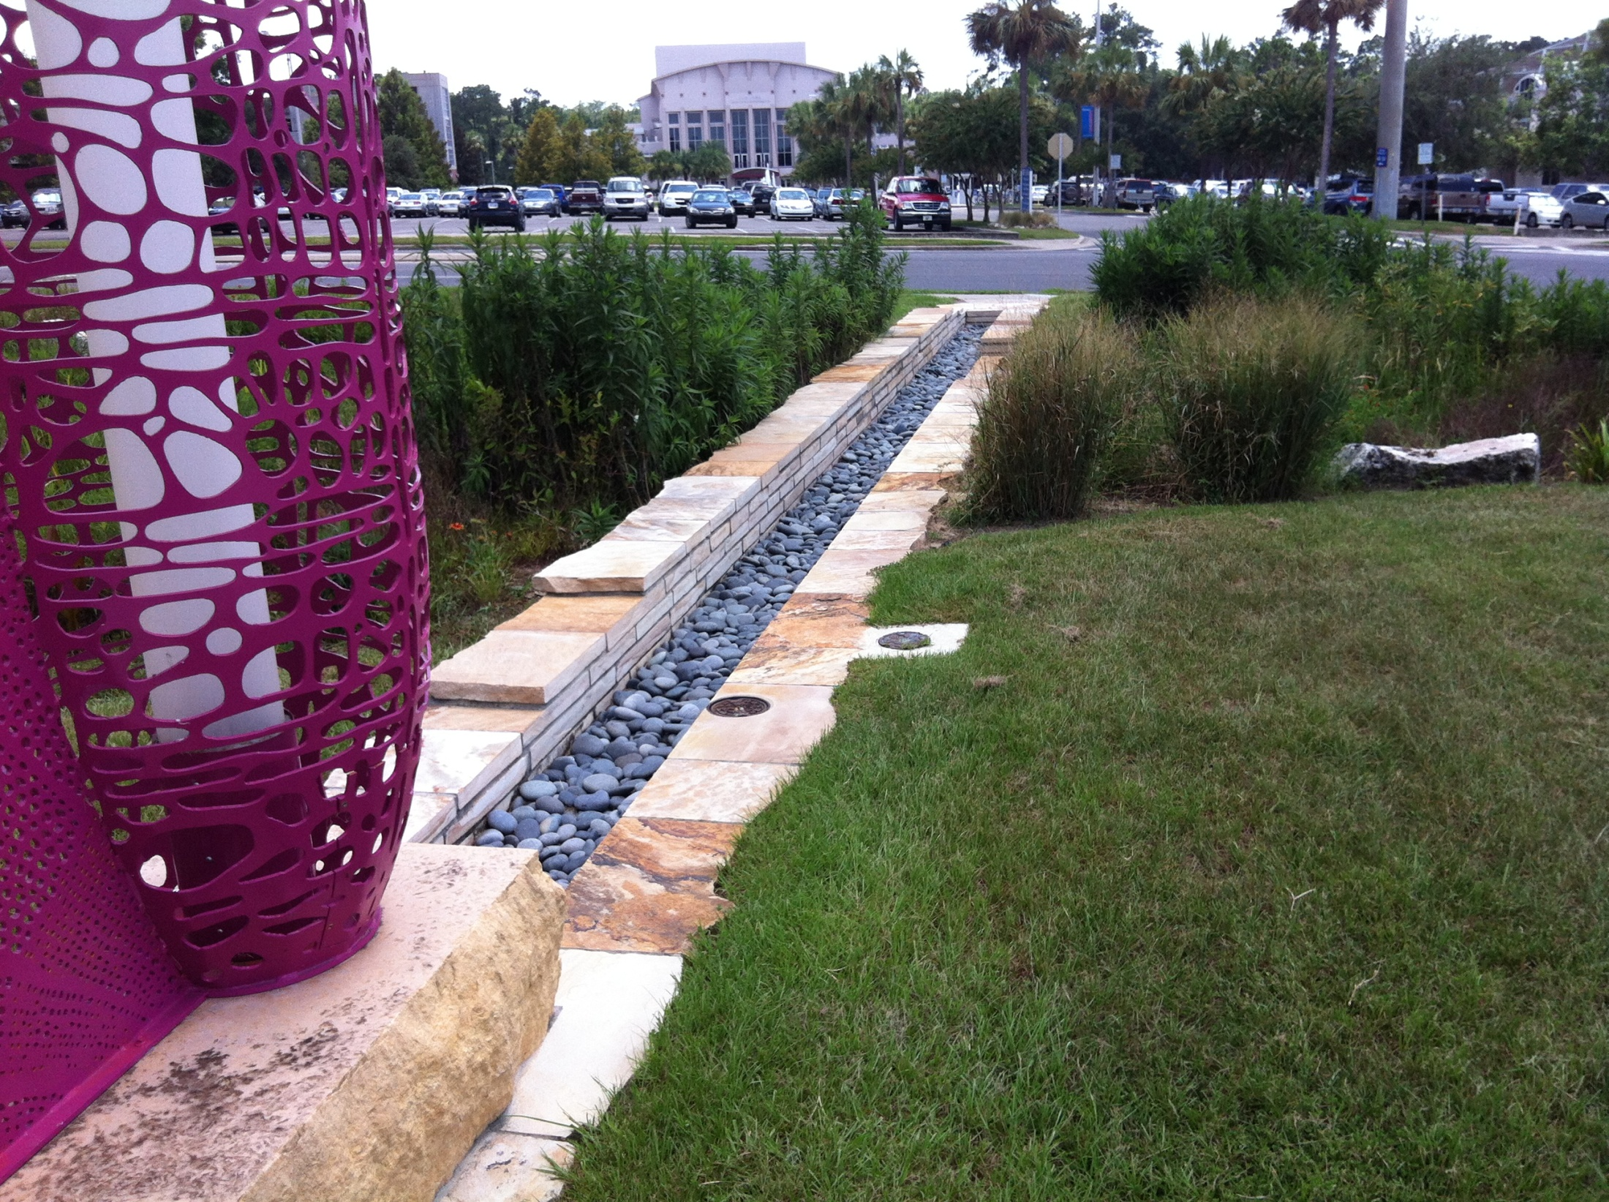
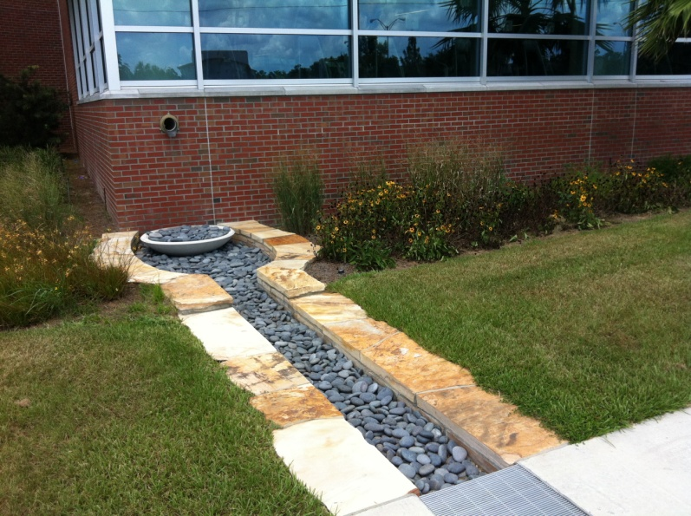
Notes:
Rain garden at UF SW Athletic Center

Slide 16
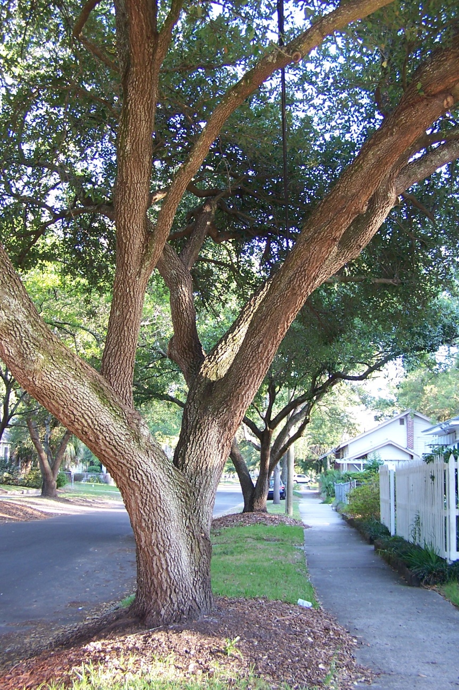
Urban Watershed Forestry
“Using urban forests to protect and restore water quality, water flows, and the health of a watershed.”
Trees intercept rainfall.
Trees take up stormwater.
Trees promote infiltration.
Trees provide critical habitat.
Trees prevent erosion.
Trees filter sediment and pollutants.
Forest litter forms the basis of the food web.
Trees save money.
Notes:
Urban watershed forestry is an integration of the fields of urban and community forestry and watershed planning. Urban and community forestry is the management of the urban forest for environmental, community, and economic benefits, while watershed planning promotes sound land use and resource management to improve water resources within a watershed. This integration of urban forestry techniques into urban watershed planning acknowledges the importance of trees and forests in protecting water resources.
Trees intercept rainfall in their canopy, reducing the amount of sot. A portion of this captured rainwater evaporates from tree surfaces.
Trees take up water from the soil through their roots. which increases soil water storage potential and lengthens the amount of time before rainfall becomes runoff.
Trees promote infiltration by slowing down runoff and by increasing soil drainage in the root zone. The addition of organic matter (e.g. leaves) also increases storage of water in the soil, further reducing runoff.
Forested land produces very little runoff, which can reduce downstream flood flows that erode stream channels, damage property and destroy habitat.
Trees growing along a stream bank prevent erosion by stabilizing the soil with root systems and the addition of organic matter.
Trees prevent erosion of sediment by stabilizing the soil, and by substantially dispersing raindrop energy.
Trees take up stormwater pollutants such as nitrogen from soil and groundwater.
Forested areas can filter sediment and associated pollutants from runoff.
Certain tree species break down pollutants commonly found in urban soils, groundwater, and runoff.
Streamside forests provide habitat in the form of leaf litter and large woody debris, for fish and other aquatic species.
Forest litter such as branches, leaves, fruits, and flowers, form the basis of the food web for stream organisms.
Source: Watershed Forestry Resource Guide, a partnership of the Center for Watershed Protection and the US Forestry Service
http://www.forestsforwatersheds.org/urban-watershed-forestry/

Slide 17
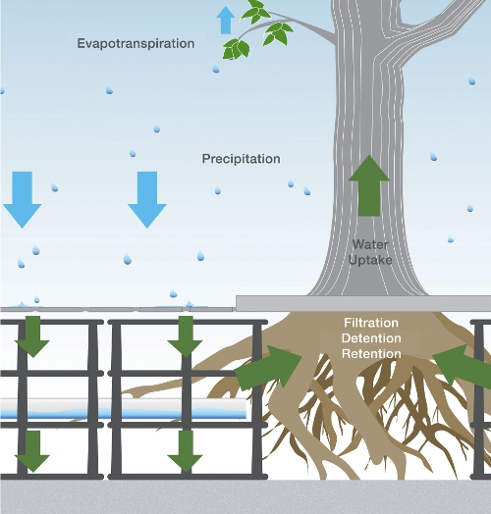
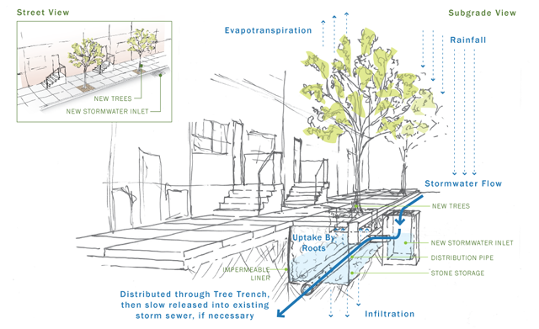
Stormwater Bioretention
Notes:
Tree Planter Photo Credit: http://www.phillywatersheds.org/what_were_doing/green_infrastructure/tools
Silva Cells Image Credit: DeepRoot Green Infrastructure, Inc.
Tree bioretention systems can provide stormwater quantity and rate-control benefits through three processes: 1) soil water storage, 2) tree interception, and 3) tree evapotranspiration.
Soil stores rainwater during and after a storm, making it available for plant growth. Stormwater runoff from nearby impervious surfaces can be directed into soil under suspended pavement using a number of different techniques – for example, pervious pavement installed over the cells or via a perforated pipe off a trench drain or manhole.
Stormwater calculations for bioretention with trees typically account only for soil water storage. However, as trees grow, they also provide greatly increasing stormwater treatment through interception and evapotranspiration. Interception is the amount of rainfall temporarily held on tree leaves and stem surfaces. This rain then drips from leaf surfaces and flows down the stem surface to the ground or evaporates. The volume of rain intercepted depends on the duration and rate of the rainfall event, tree architecture (leaf and stem surface area, roughness, visual density of the crown, tree size, and foliation period), and other meteorological factors.
Evapotranspiration is the sum of water evaporated from soil and plant surfaces and the water lost as a result of transpiration, a process in which trees absorb water through their roots and transfer it up to the leaves, where it evaporates into the environment through leaf pore transpiration. Evapotranspiration continues to reduce stormwater volume stored in the soil long after a rainfall event ends. Transpiration rate is influenced by factors such as tree species, size, soil moisture, increasing sunlight (duration and intensity), air temperature, wind speed, and decreasing relative humidity.
The soil and its microbes, together with the trees in a tree bioretention system, also work together to improve water quality of stormwater that is filtered through the bioretention soil. Some pollutants are held or filtered by soil, others are taken up or transformed by plants or microbes, and still others are first held by soil and then taken up by vegetation or degraded by bacteria, "recharging" the soil's sorption capacity in between rain events.
The Silva Cell protects the soil from compaction and the modular design enables flexibility to size the rooting/bioretention volume as needed for each site.
http://www.cenews.com/print-magazinearticle-stormwater_benefits_of_large_t-8464.html

Slide 18
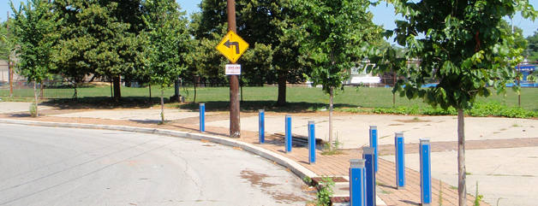
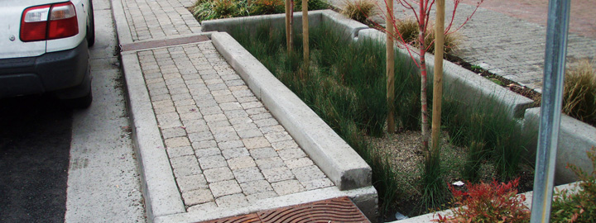
Tree Trenches & Planters
Notes:
Photo/Image Credit: http://www.phillywatersheds.org/what_were_doing/green_infrastructure/tools
A stormwater tree trench is a system of trees that are connected by an underground infiltration structure. On the surface, a stormwater tree trench looks just like a series of street tree pits. However, under the sidewalk, there is an engineered system to manage the incoming runoff. This system is composed of a trench dug along the sidewalk, lined with a permeable geotextile fabric, filled with stone or gravel, and topped off with soil and trees. Stormwater runoff flows through a special inlet (storm drain) leading to the stormwater tree trench. The runoff is stored in the empty spaces between the stones, watering the trees and slowly infiltrating through the bottom. If the capacity of this system is exceeded, stormwater runoff can bypass it entirely and flow into an existing street inlet.
http://www.phillywatersheds.org/what_were_doing/green_infrastructure/tools

Slide 19
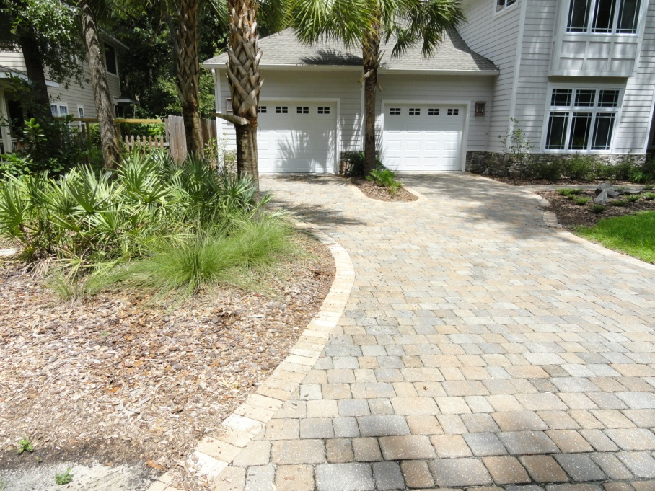
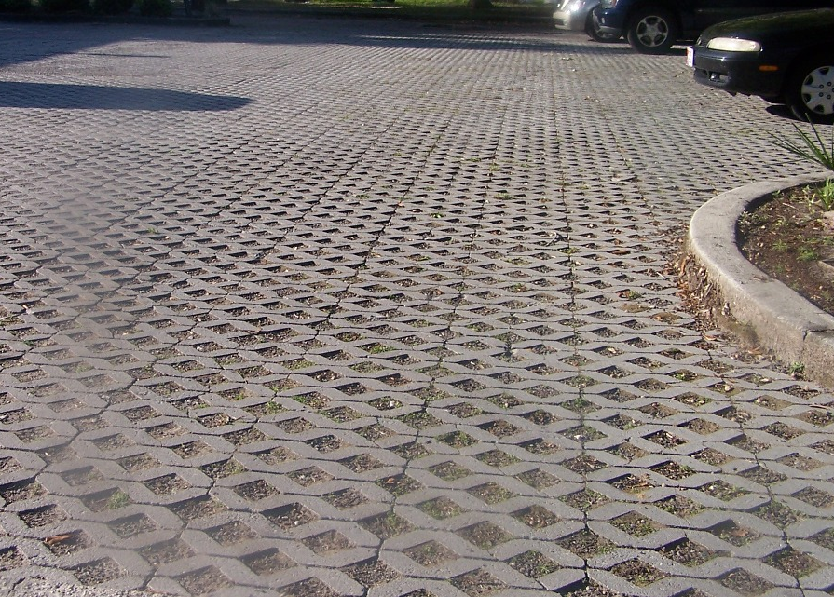
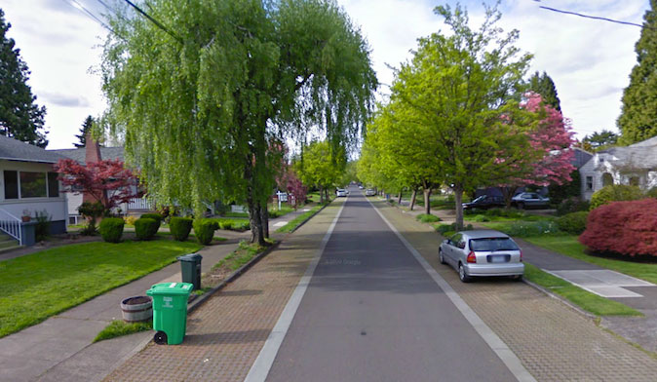
Pervious Pavers and Concrete
Notes:
Other strategies involve using pervious materials. Here are some examples of pervious driveways and walkways that help to reduce stormwater runoff. In these pictures, we see pervious pavers, pervious concrete, and a gravel driveway.
Permeable pavement
Permeable pavement is an alternative to asphalt or concrete surfaces that allows stormwater to drain through the porous surface The appearance of the alternative surface is often similar to asphalt or concrete, but it is manufactured without fine materials and instead incorporates void spaces that allow for storage and infiltration.
Permeable pavers
Permeable pavers promote groundwater recharge by creating voids between blocks.
EPA Stormwater BMPs: http://www.epa.gov/oaintrnt/stormwater/best_practices.htm
Photos:
Top left – Pervious pavers at Madera in Gainesville
Top right – Pavers in parking lot in Riverside
Bottom left – Pervious concrete walkway at Lasalle Bioswale in San Marco
Bottom right – Pervious street parking in Portland (credit: http://townsandcities.org/page/2)

Slide 20
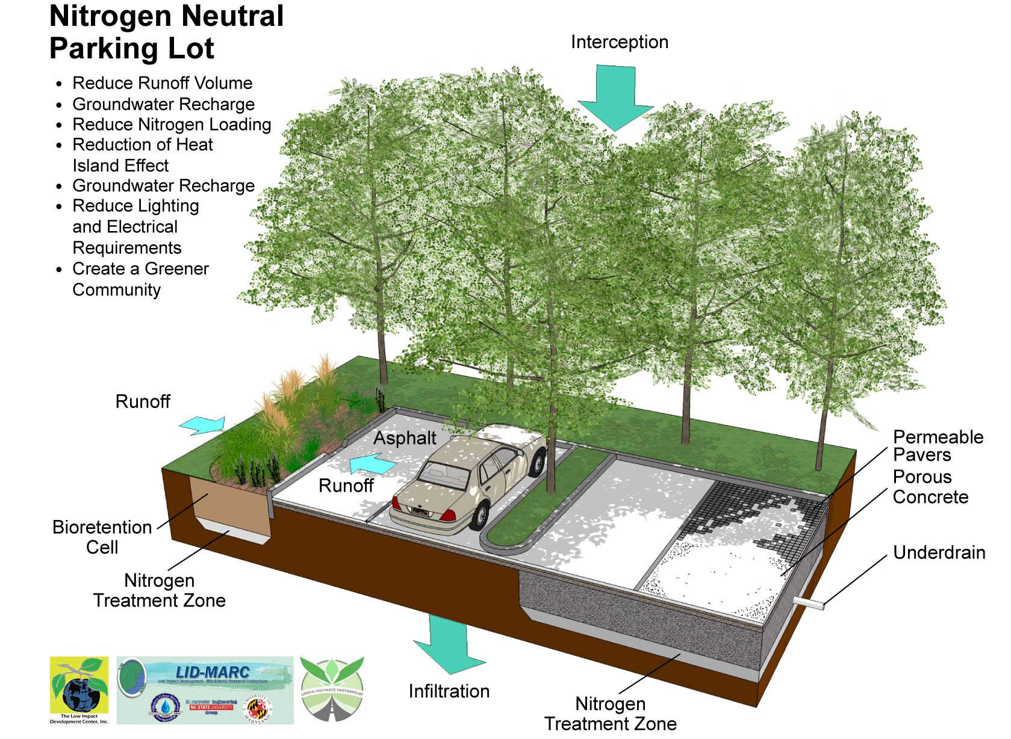
Notes:
This slide shows the use of bioretention cells, trees, and pervious pavers and concrete to create a nitrogen neutral parking lot.

Slide 21
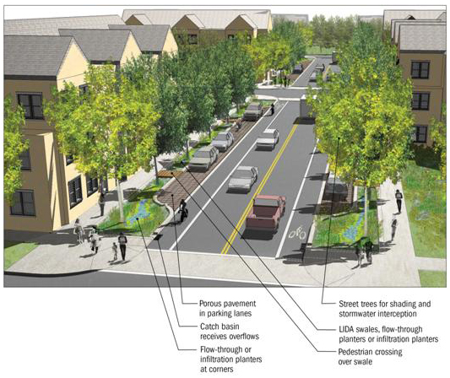
Porous pavement
In parking lanes
Catch basin
receives overflows
Flow-through or
infiltration planters at corner
Street trees for shading and stormwater interception
Swales, flow-through
or infiltration planters
Pedestrian crossing
over swale
Green Streets
Notes:
Green streets are public or private streets that incorporate a system of stormwater detention and treatment within the right-of-way. Green streets:
Minimize water that is piped to streams and rivers;
Make visible a system of “green” infrastructure;
Maximize street tree coverage to intercept stormwater, mitigate temperatures, and improve air quality.
Source: http://www.co.washington.or.us/LUT/Divisions/CurrentPlanning/GreeningCode/Conservation/green-streets.cfm

Slide 22
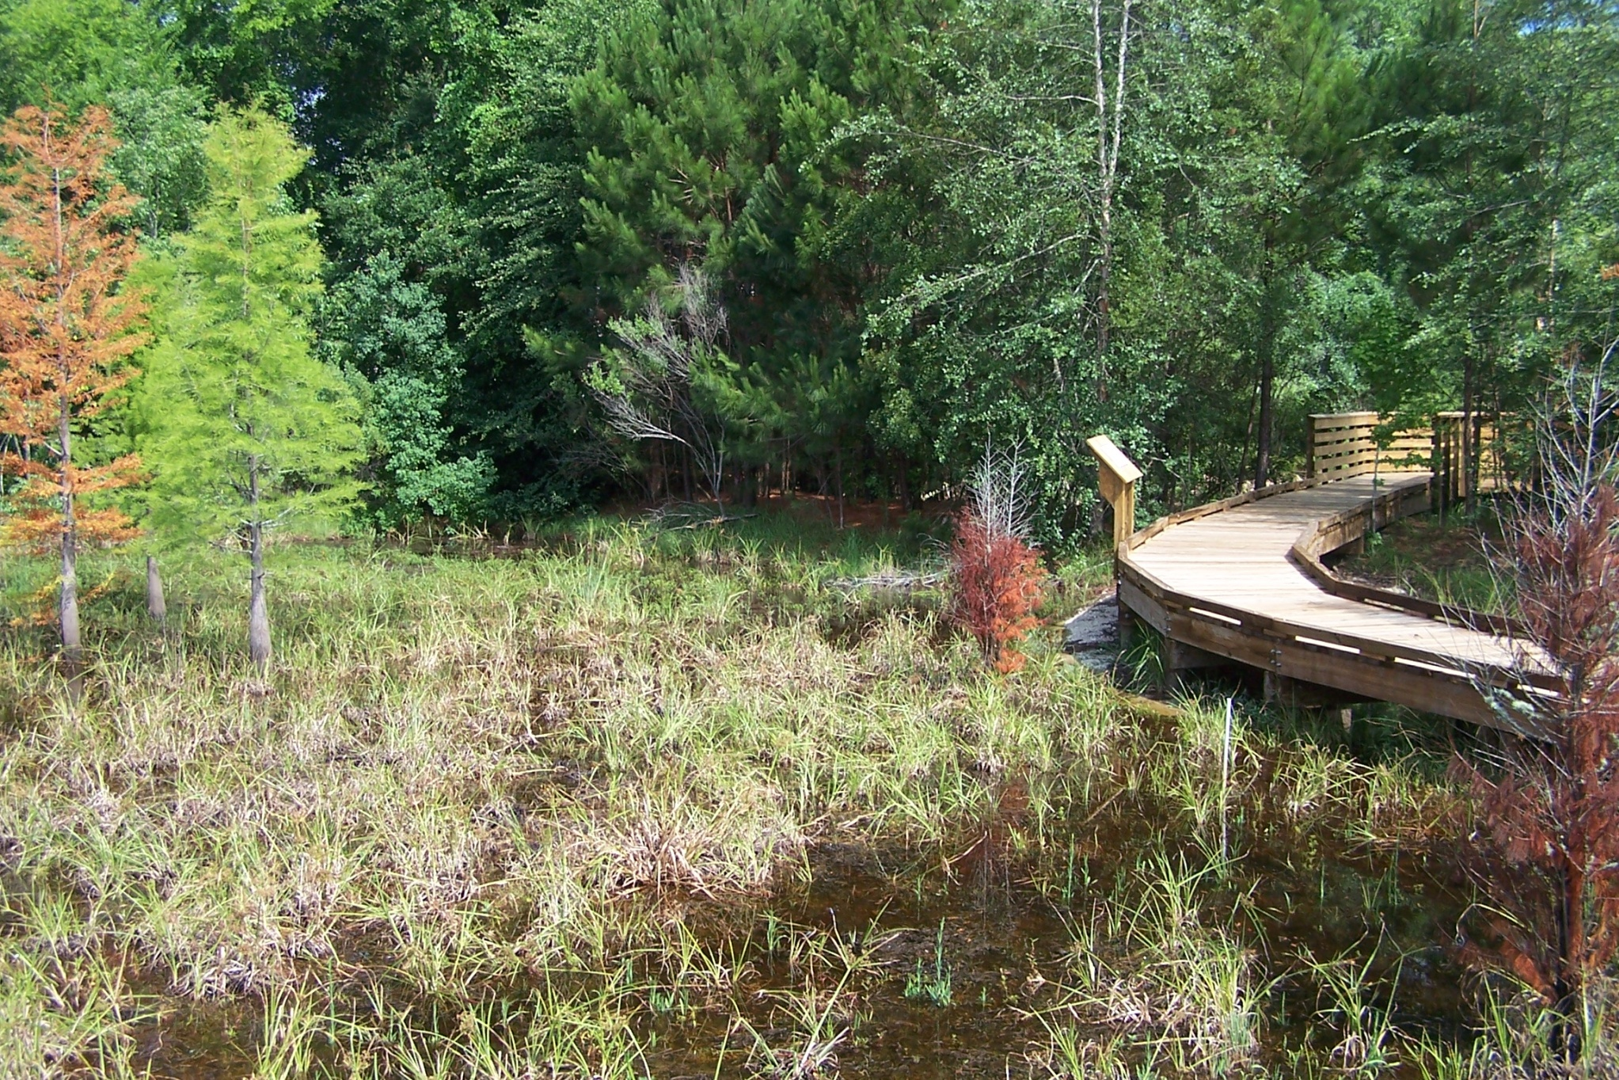
Enhanced Stormwater Basins
Notes:
http://buildgreen.ufl.edu/Fact_sheet_Enhanced_Stormwater_Basins.pdf
University of Florida Stormwater Ecological Enhancement Project (SEEP) - http://natl.ifas.ufl.edu/seepgall.html, http://natl.ifas.ufl.edu/SEEPposter.pdf

Slide 23
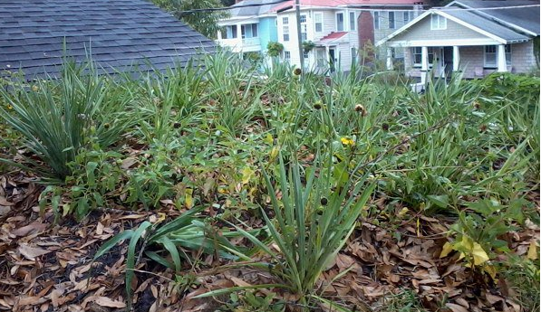
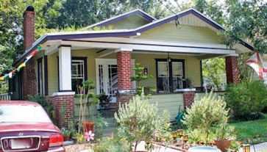
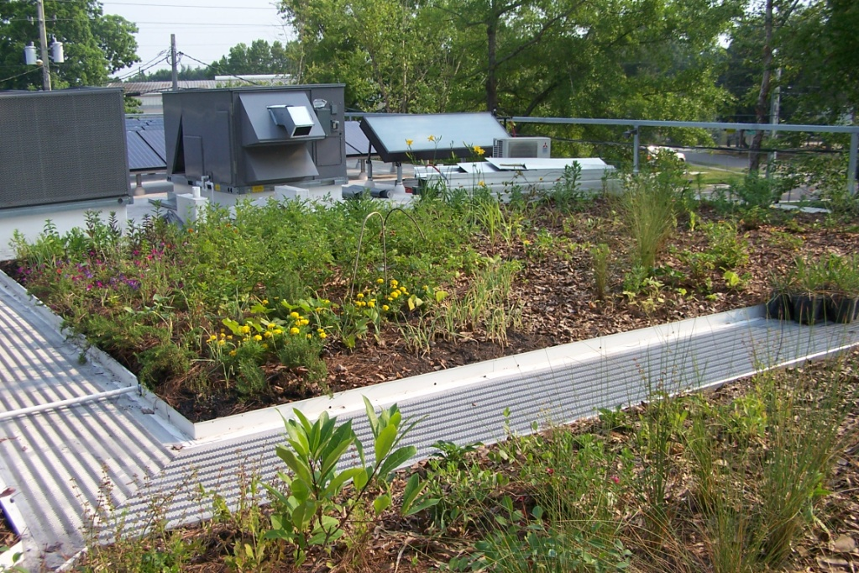
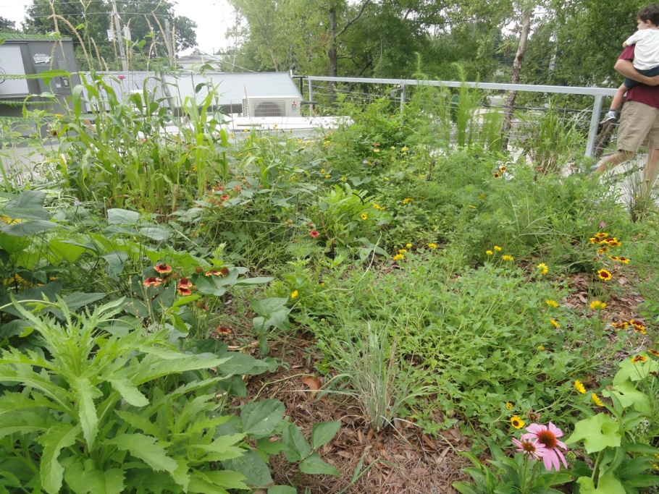
Green Roofs
Notes:
Top left – our green roof, top right – front view of our green roof, bottom left – Breaking Ground Contracting , bottom right- Breaking Ground Contracting
EPA Stormwater BMPs: http://www.epa.gov/oaintrnt/stormwater/best_practices.htm
A living roof, green roof or vegetated roof is a roof on a structure that is partially or completely covered with vegetation tolerant of heat, drought, and periodic inundations planted in a growing medium, planted over a waterproofing membrane.
Living roofs serve several purposes for a building, such as absorbing and reducing rainwater and runoff volume, providing insulation, creating a habitat for wildlife, and helping to lower urban air temperatures. They have reduced replacement and maintenance costs and longer life cycles compared to traditional roofs.
We installed a living roof over the open air porch on our 1927 bungalow. This section of the roof (120 sq ft) was not historic to the house and already had a rolled roof that was in need of replacement. I met with RAP and later with a city planner to review the plans prior to applying for a certificate of appropriateness (COA) and presenting our case to the Jacksonville Historic Preservation Committee where it was ultimately approved with conditions on set back and average plant height.

Slide 24
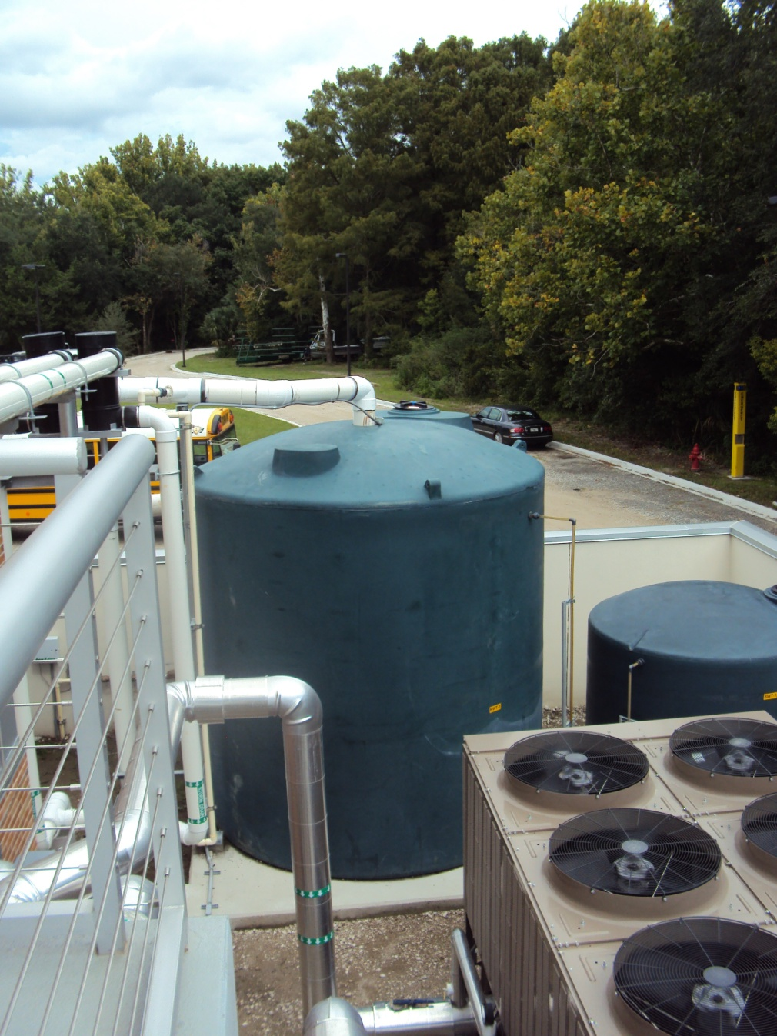
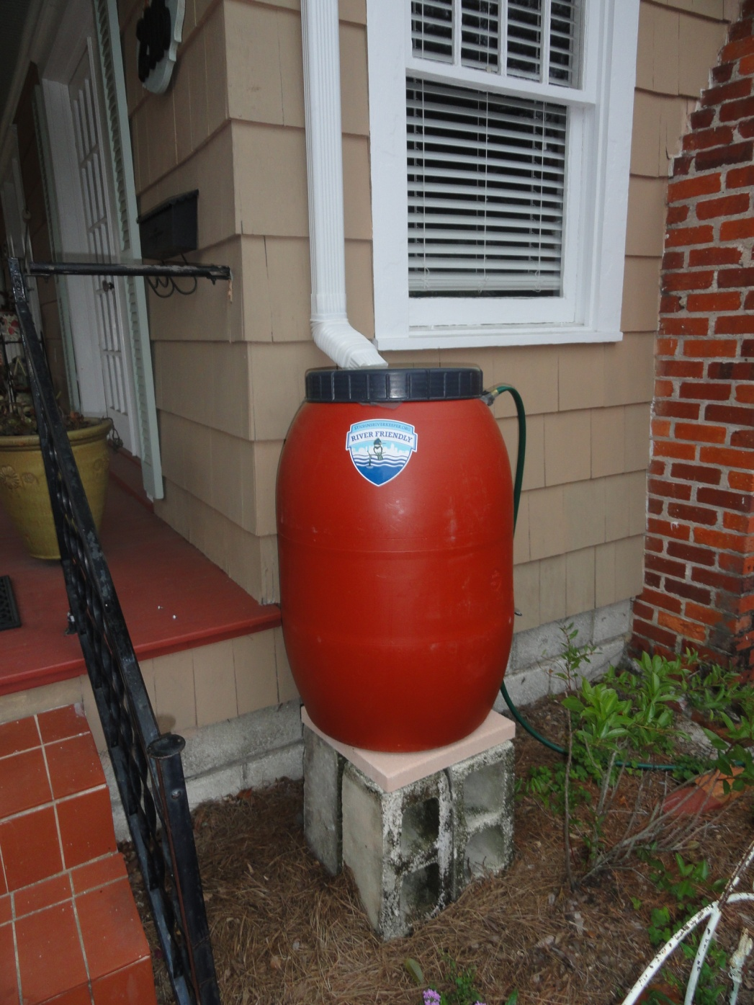
Rainwater Harvesting
Notes:
This slide shows two examples of rainwater harvesting systems – (top, left) large cisterns at the MSRI at JU (10,000 gallon capacity) and (right) and a traditional rain barrel installed at a Riverside home. Subterranean systems are also available.
What is a rain barrel?
A rain barrel is a simple way to harvest rainwater by collecting water runoff from your roof. Most rain barrels hold approximately 55 gallons of water.
Where do I put it?
Rain barrels can be used anywhere water flows off your roof. Many houses have gutters, and a rain barrel can be attached to the downspout. You can also collect rain off of your roof, even if you don't have gutter. Position the barrel near a valley in your roof where water is directed and flows off the roof.
How can I use the water?
Water collected in rain barrels is devoid of chemicals and treatments including fluoride and chlorine and is therefore better for the lawn or garden. You can attach a garden hose, soaker hose, or use a watering can under the spigot. The water should not be used for drinking.
Why should I use one?
The average person living in the watershed of the St. Johns River uses approximately 140 gallons a day and more than 50% of that water is for outdoor use. An inch of rain produces 625 gallons of water runoff from a 1,000 square-foot roof. You can conserve hundreds of gallons of water with every inch of rain and lower your water bill!

Slide 25
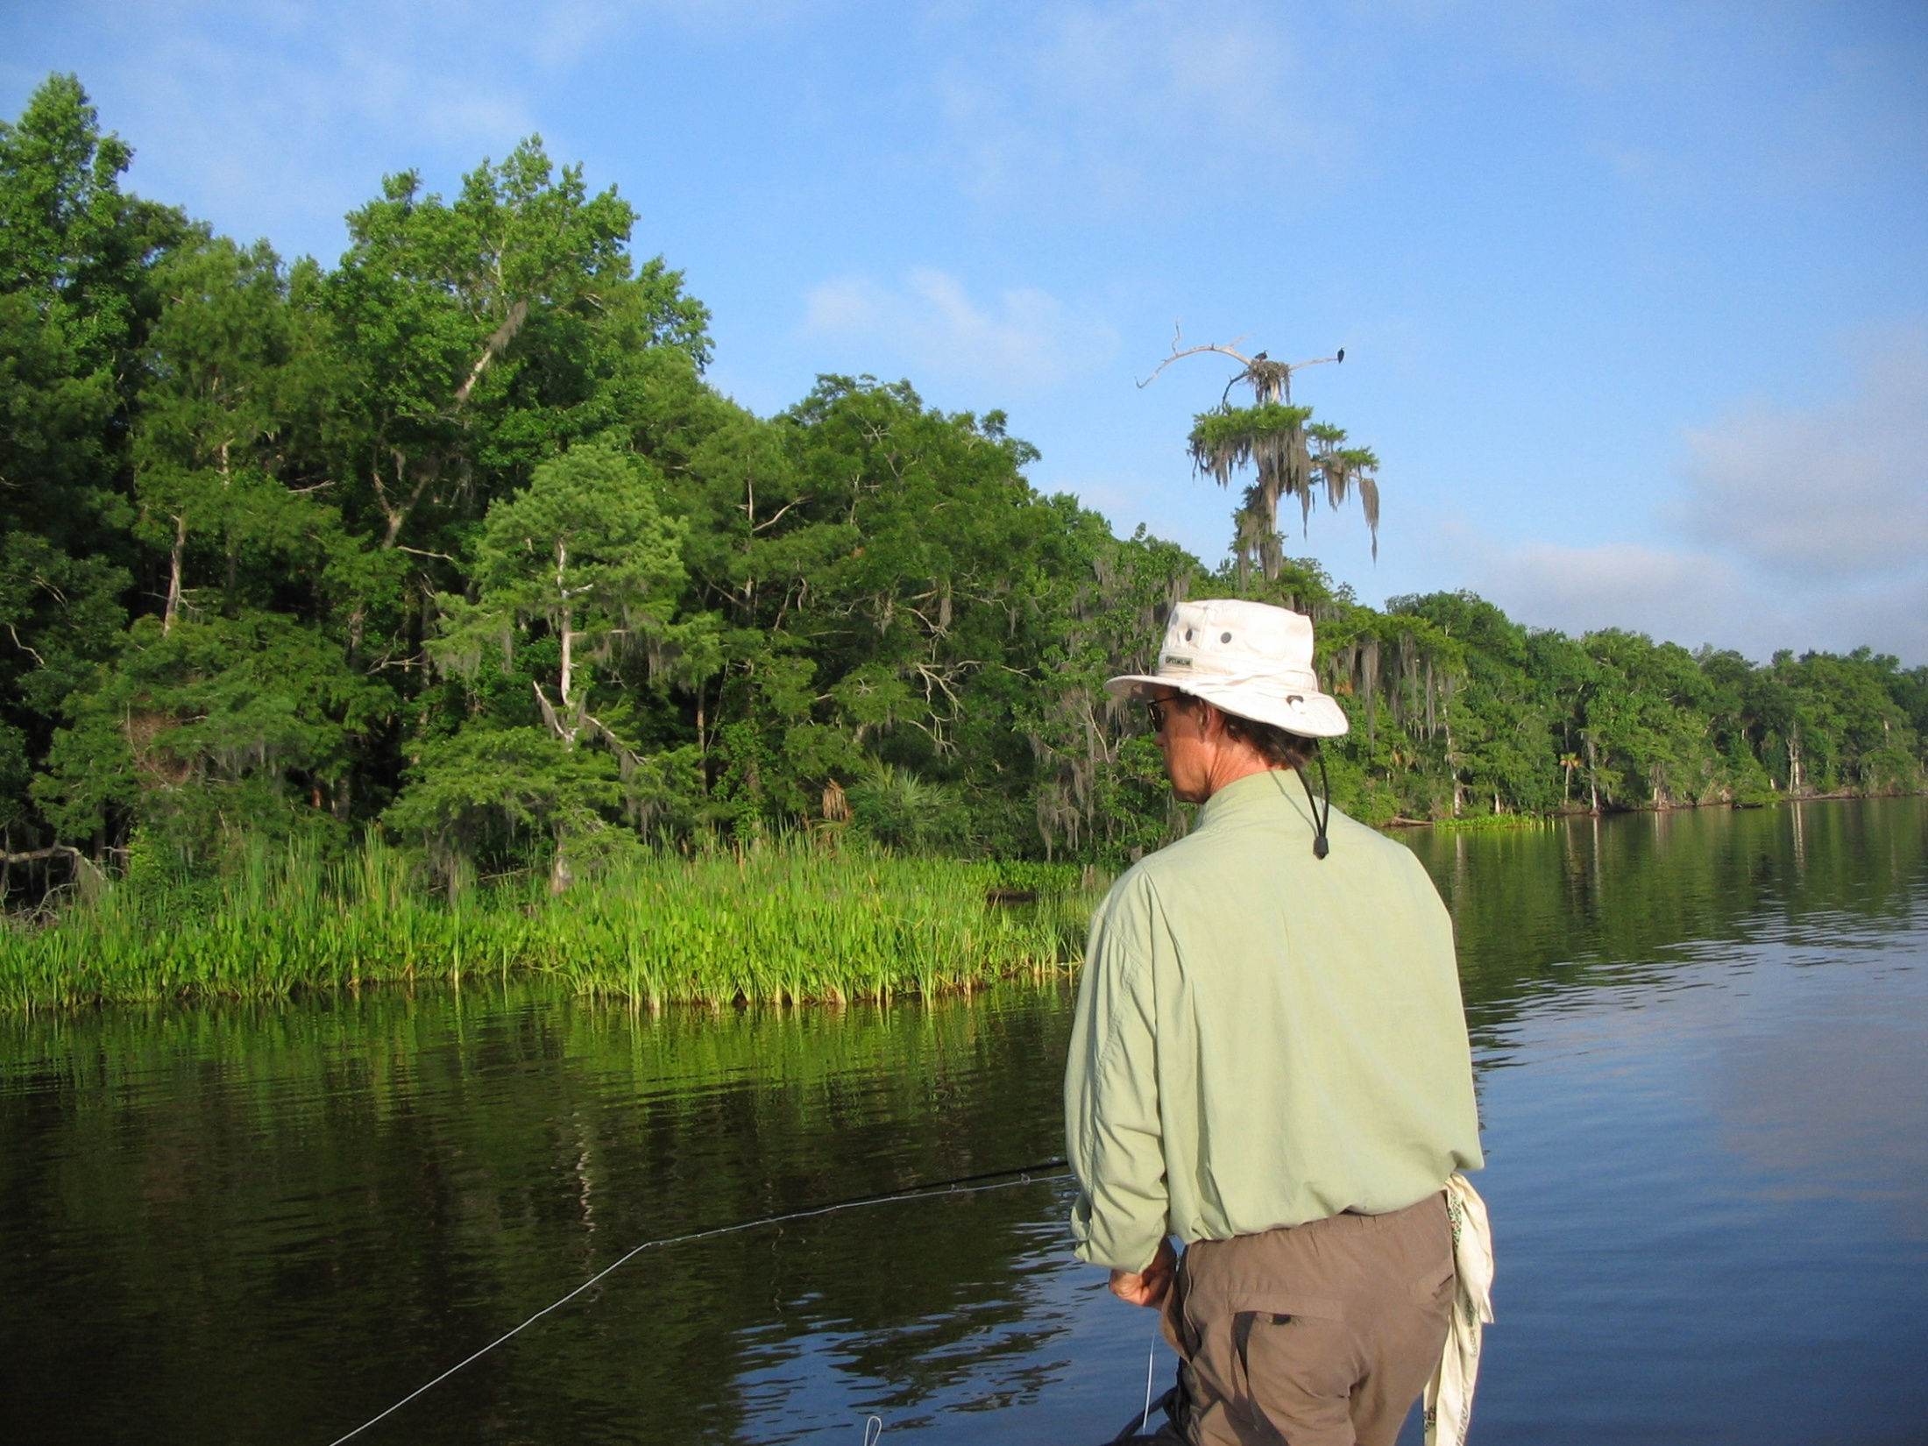
Notes:
If we all do our part by being River Friendly, we can have a clean and healthy St. Johns River.

