Slide 1
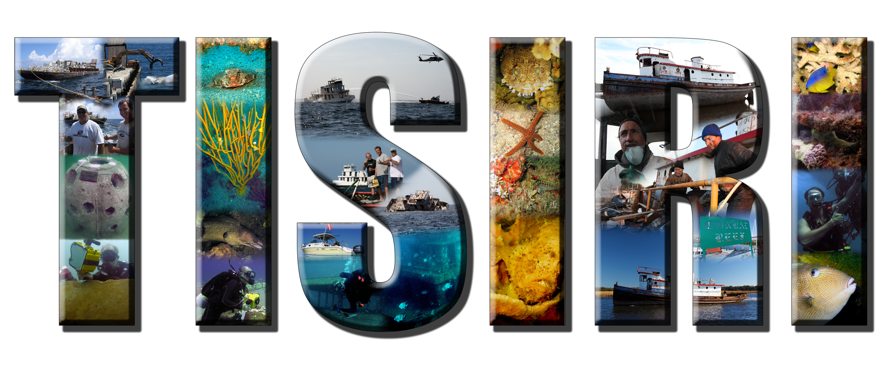

Slide 2
The Spike

Slide 3
Concrete Deployment 09

Slide 4
Concrete Deployment 2011

Slide 5
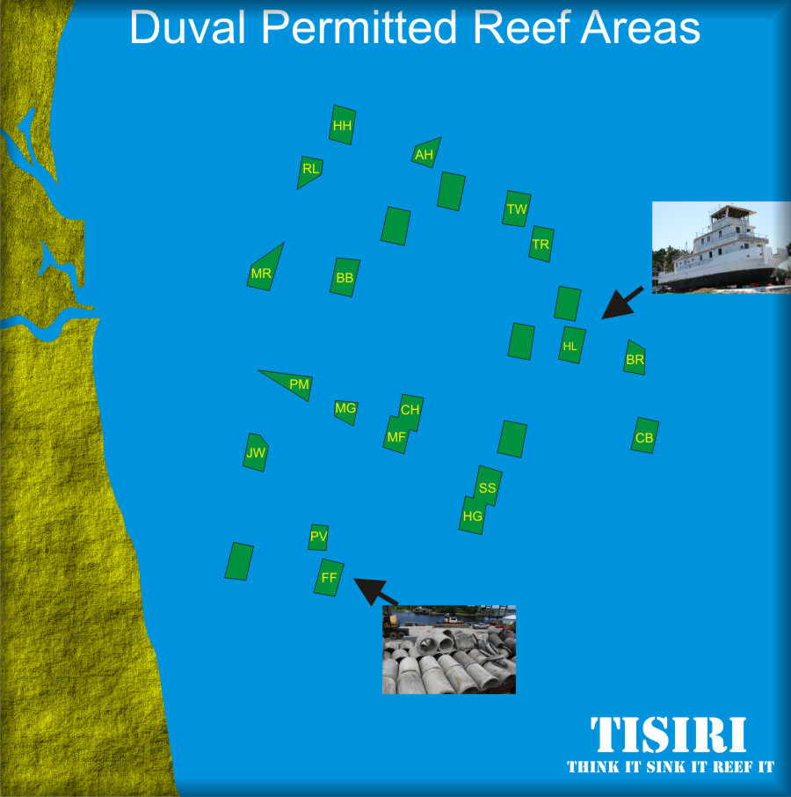

Slide 6
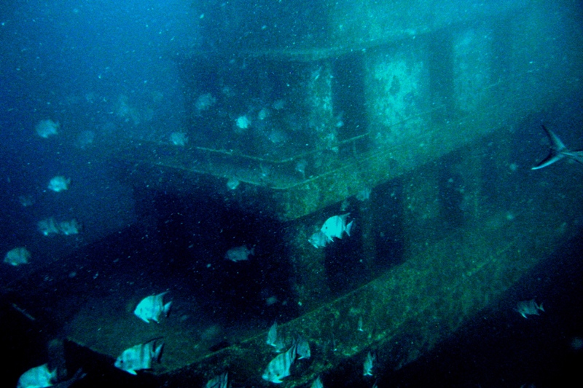
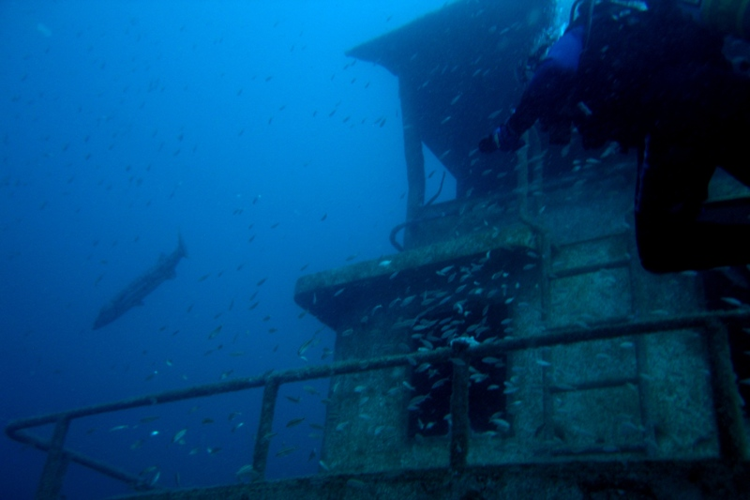
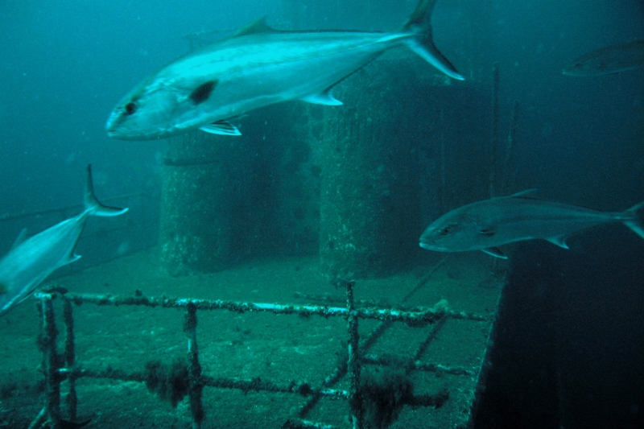
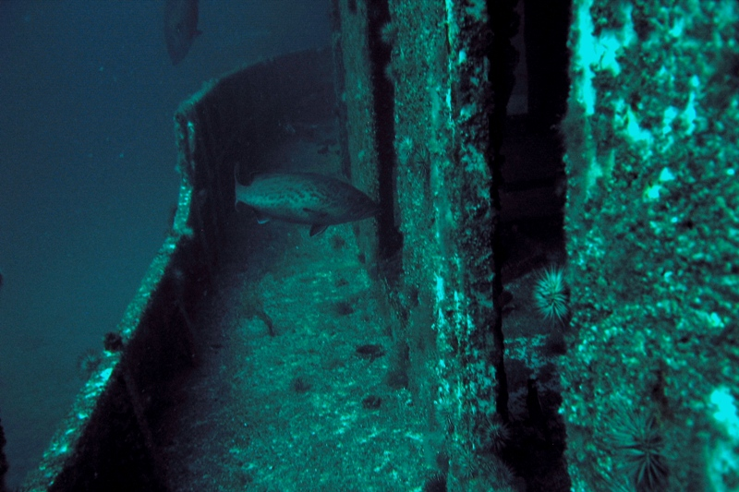
TISIRI.ORG
Notes:
Same reef a several months later
algal and invertebrate growth, small fish, top predator fish
What might a reef look like much later?

Slide 7
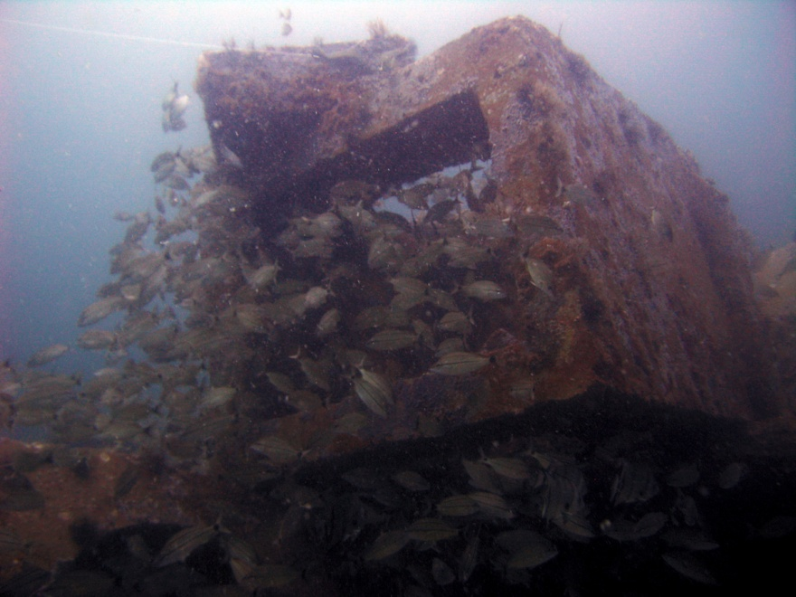
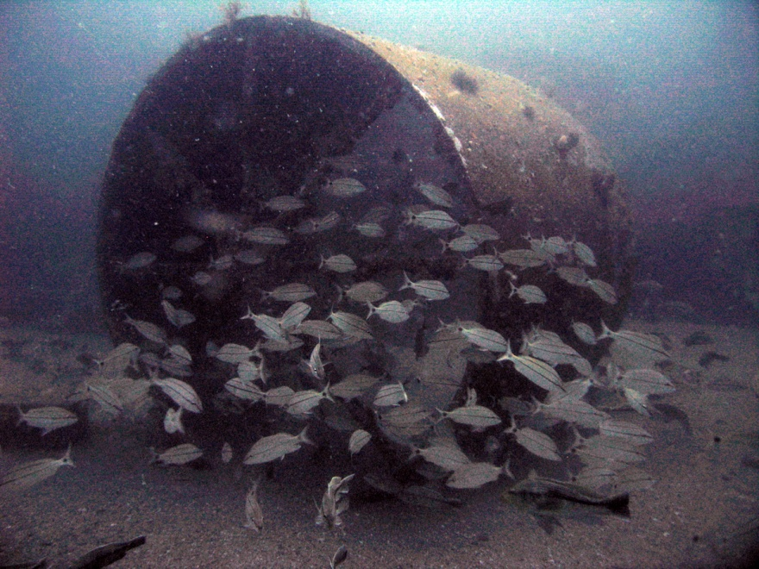
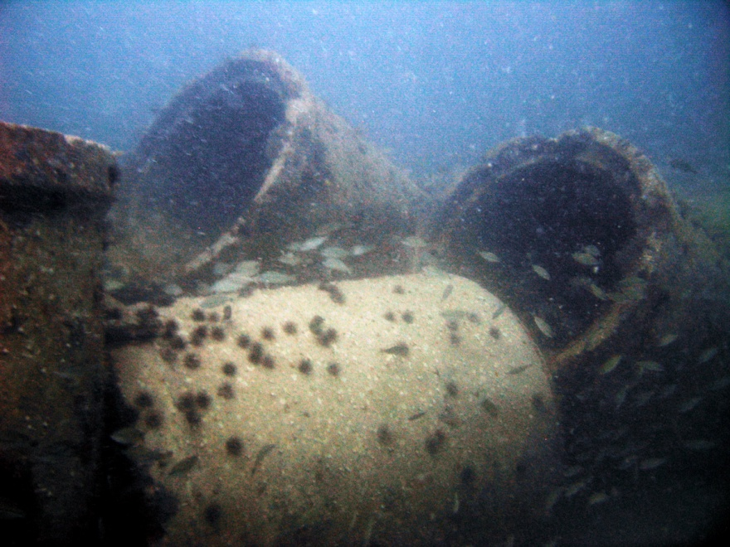

Slide 8
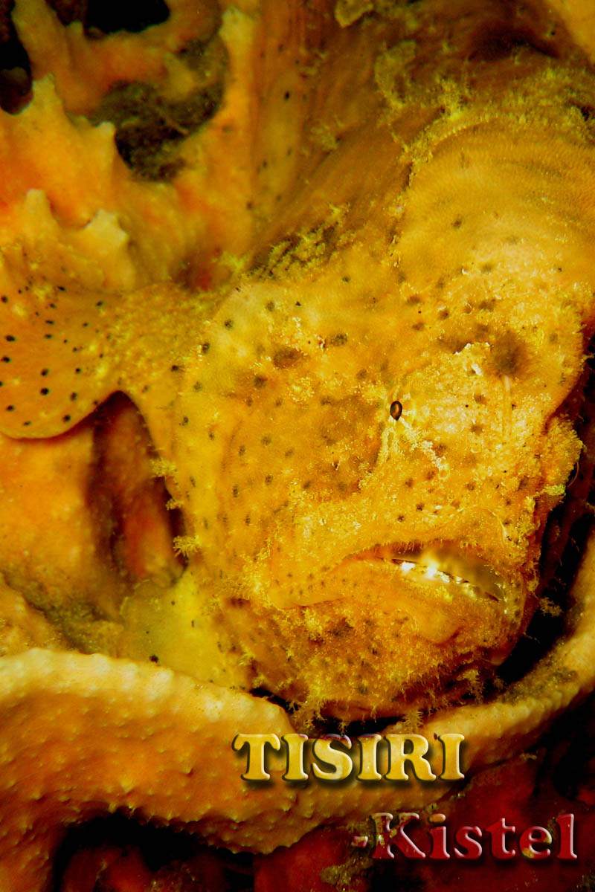
Reef Creation Process
Site selection
Permitting
Sea floor survey
Material selection
Material preparation
Regulatory approvals
Deployment

Slide 9
www.TISIRI.ORG

